Slide 1

A Connected Vehicle World
- A look at the impact of deployment to the transportation practitioner
Brian Burkhard, PE
Vice President
National ITS & Northern California Practice Leader
Connected Vehicles Technology and Deployment – Impact to Transportation Agencies
– January 29, Rancho Cordova CA 95670
What Transportation can be
Notes:
Opening Slide

Slide 2
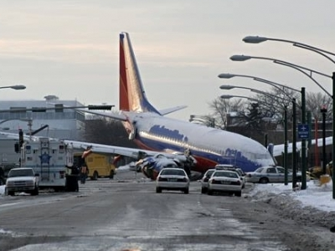
A Different Perspective
1 fatal airline crash/day
Vehicle deaths per year
=
32,000

Slide 3
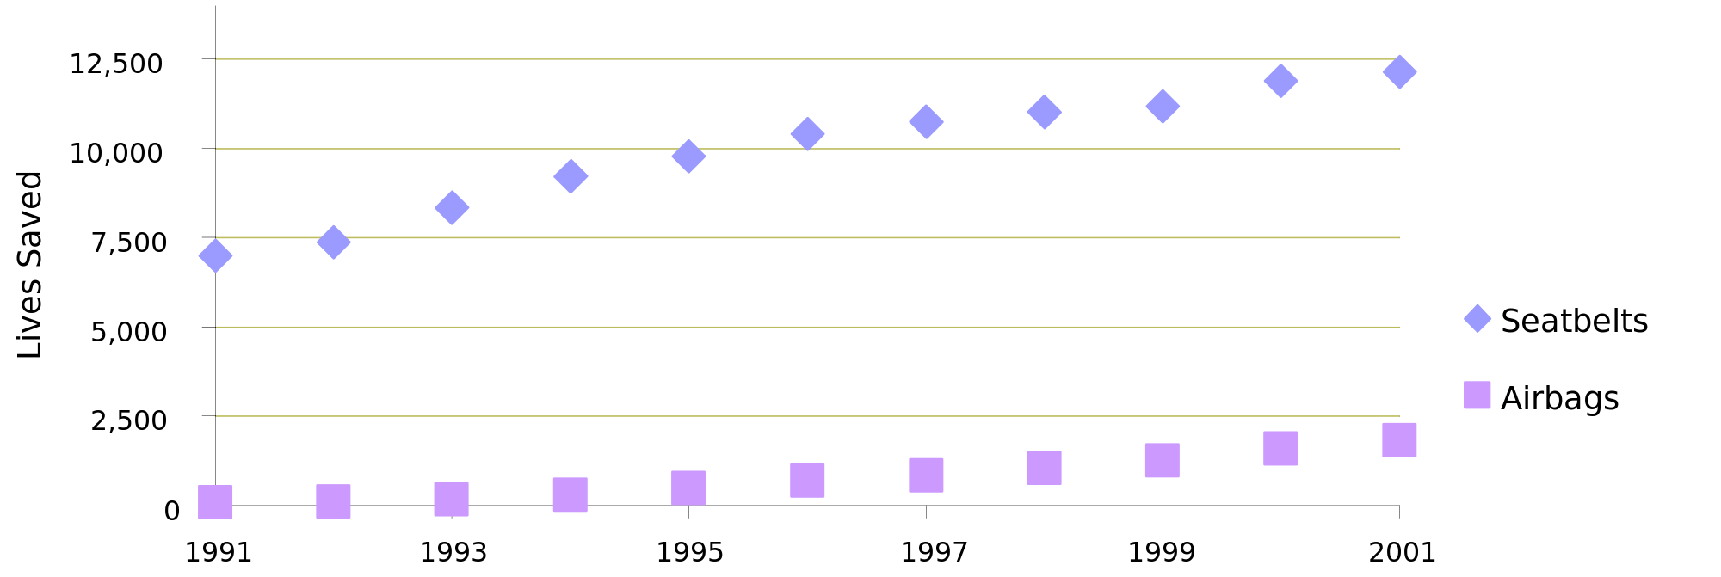
What we’ve done before
Wide scale vehicle safety programs
Source: NHTSA

Slide 4
What we could do
A new trend could be in the making.
What connected vehicles could do. .
“. . .address 80% of non-impaired crash scenarios.”
Source: NHTSA

Slide 5
The Importance of the Safety Pilot
“. . .This research should bring
us a step closer to what could be the next
major safety breakthrough.”
—Ray LaHood

Slide 6
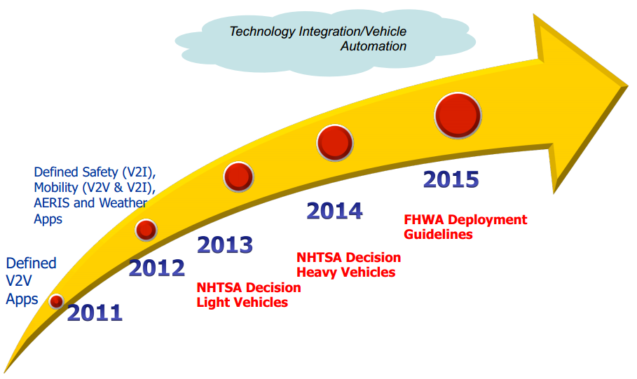
The Deployment Plan
Future regulatory action
Part of New Car Assessment Program (higher safety ratings)
More research needed
No-go
Source: USDOT

Slide 7

Future regulatory action
Part of New Car Assessment Program (higher safety ratings)
More research needed
No-go
National Connected Vehicle Field Infrastructure Footprint Analysis

Slide 8
Impact to practitioner
National Connected Vehicle Field Infrastructure Footprint Analysis
Justification for and value
What is needed to realize
High level concepts
Engage select agencies for strategies
Create scenario templates
Phased implementation

Slide 9
Major Study Focal Points
High-Level Deployment Concepts – creates big picture in various settings, common technical considerations
Deployment Scenarios – describes specific build outs by agency of application sets (or coalition) in various contexts, a base scenario, and gaps

Slide 10
High-Level Deployment Concepts

Slide 11
The physical settings
Rural
Urban – Highway, intersection, corridor
Freight – Facility, parking, roadside
International Border Crossings
DOT Operations and Maintenance
Fee Payment

Slide 12
The impacts to infrastructure
Installation
Location
Density
Connectivity
Operations
Maintenance
Cost

Slide 13
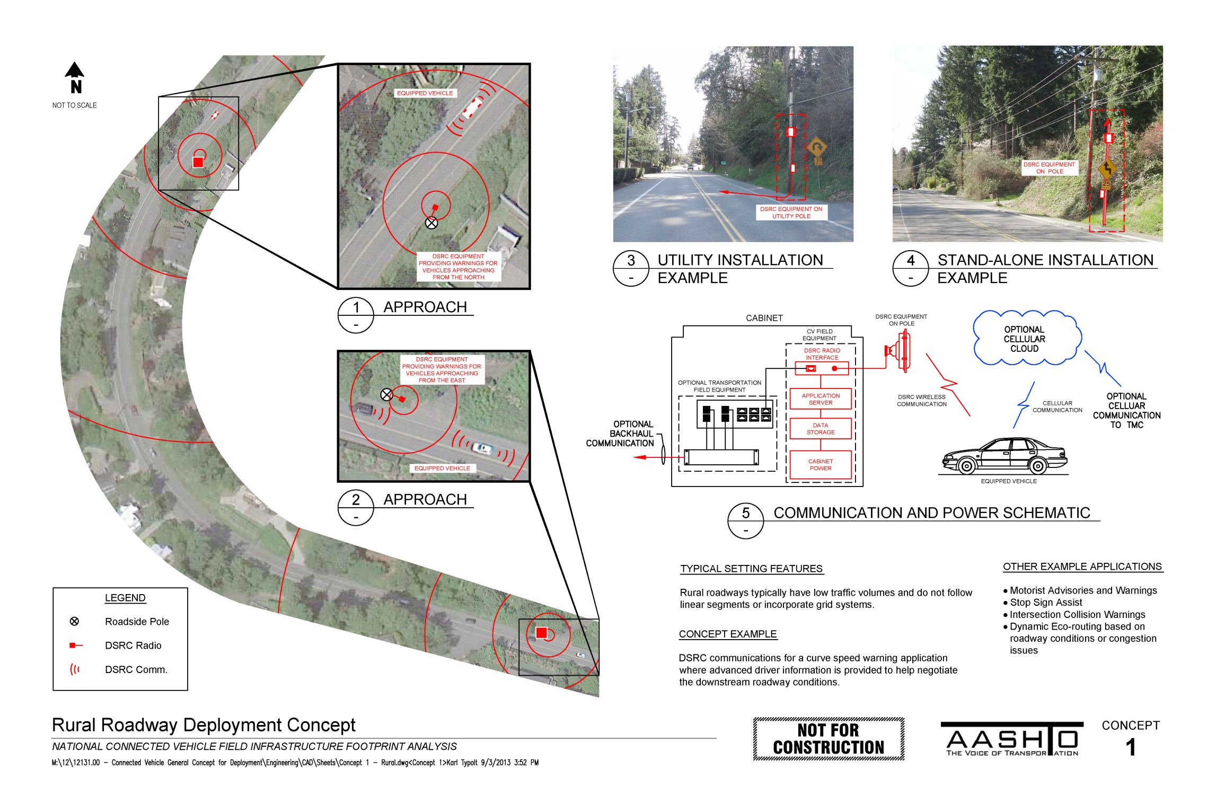

Slide 14
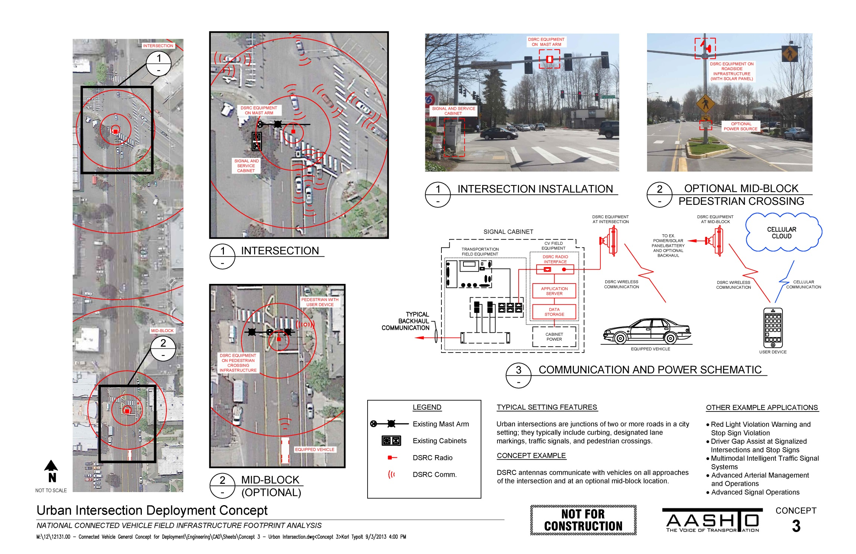

Slide 15
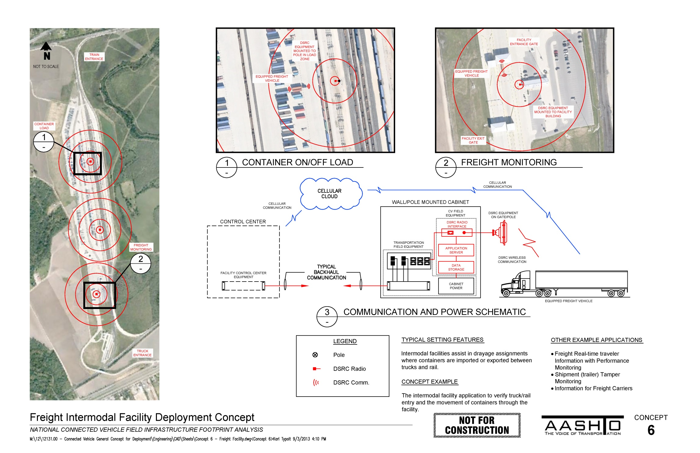

Slide 16
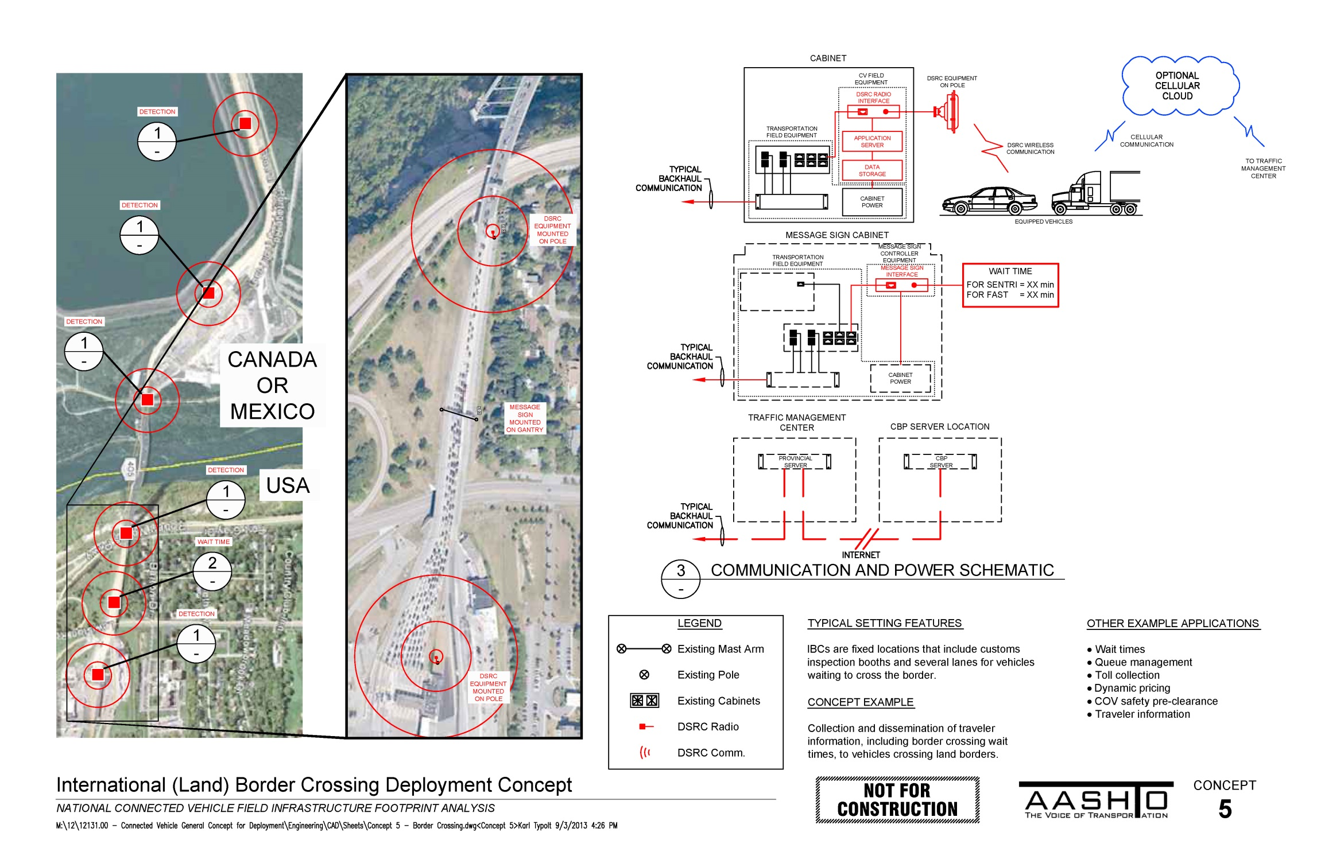

Slide 17
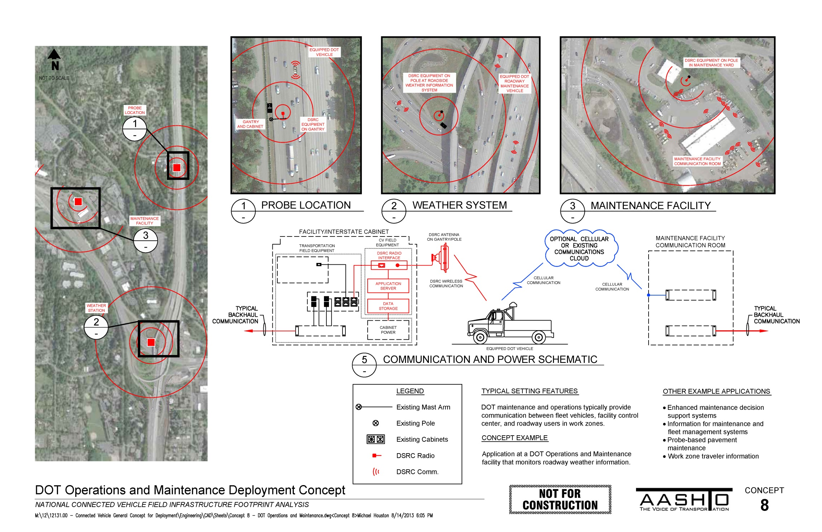

Slide 18
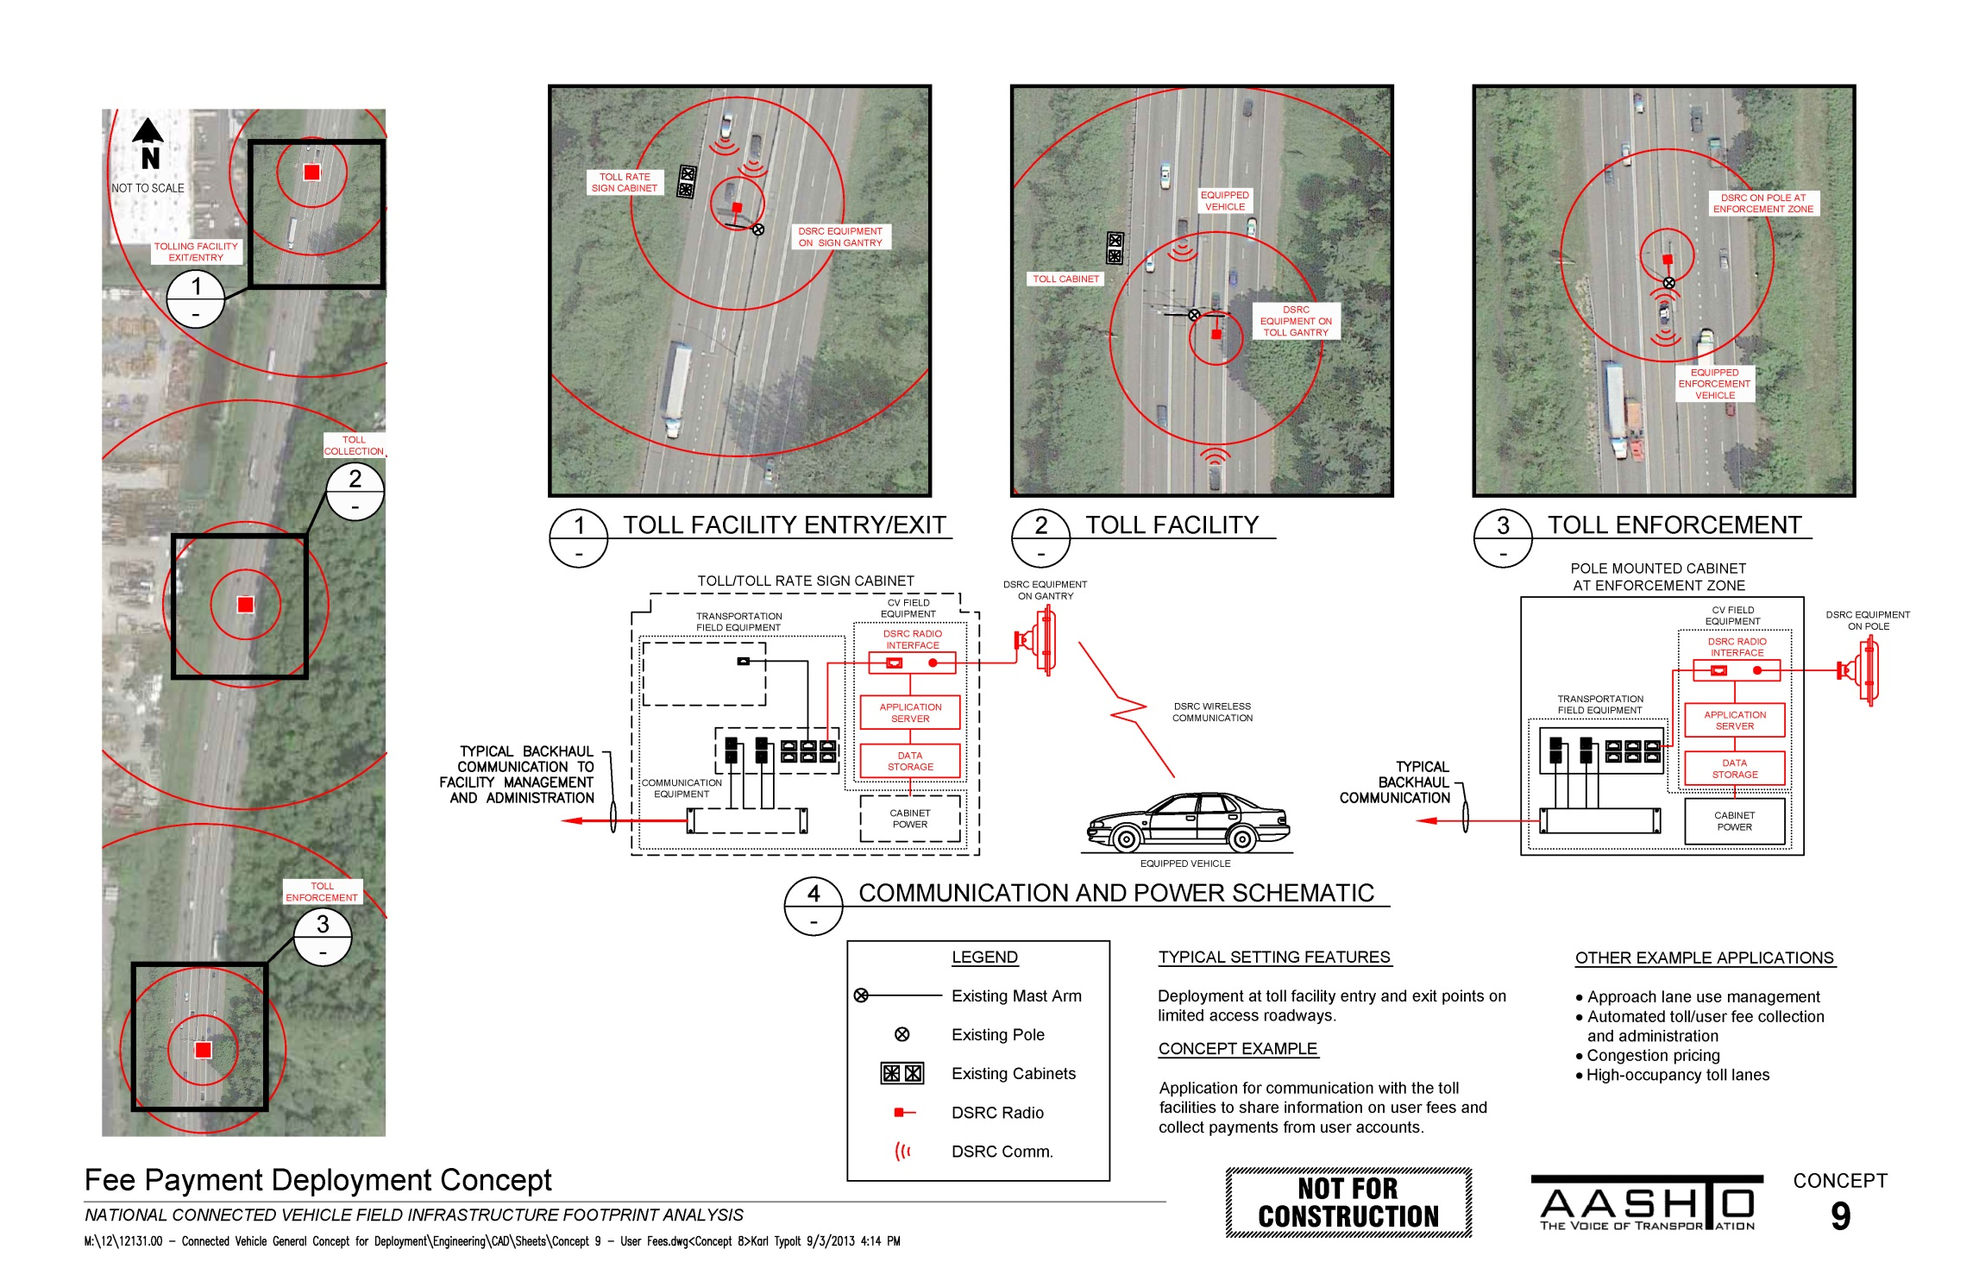

Slide 19
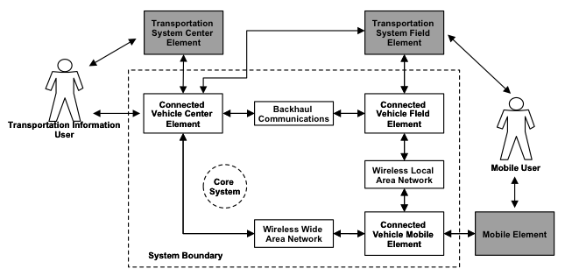
Common Considerations to Concepts
Architectures - Core System and the Connected Vehicle Reference Implementation Architecture (CVRIA)

Slide 20
Common Considerations to Concepts

Slide 21
Common Considerations to Concepts
Standardized data/messages – SAE J2735
 | V2V | V2I | I2V
Basic Safety Message Part 1 | ✓ | ✓
Basic Safety Message Part 2 | ✓ | ✓
Emergency Vehicle Alert | ✓
Common Safety Request | ✓
Probe Vehicle Data |  | ✓
Signal Request Message |  | ✓
Roadside Alert |  |  | ✓
Traveler Information |  |  | ✓
MAP Data |  |  | ✓
Probe Data Management |  |  | ✓
Signal Phase and Timing |  |  | ✓
Signal State Message |  |  | ✓
NMEA Corrections |  |  | ✓
RTCM Corrections |  |  | ✓

Slide 22
Common Considerations to Concepts
V2I Communications
  DSRC - Latency 5 – 100 mSec
  Cellular LTE - Latency 30 – 60 mSec

Slide 23
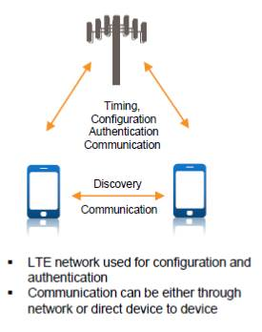
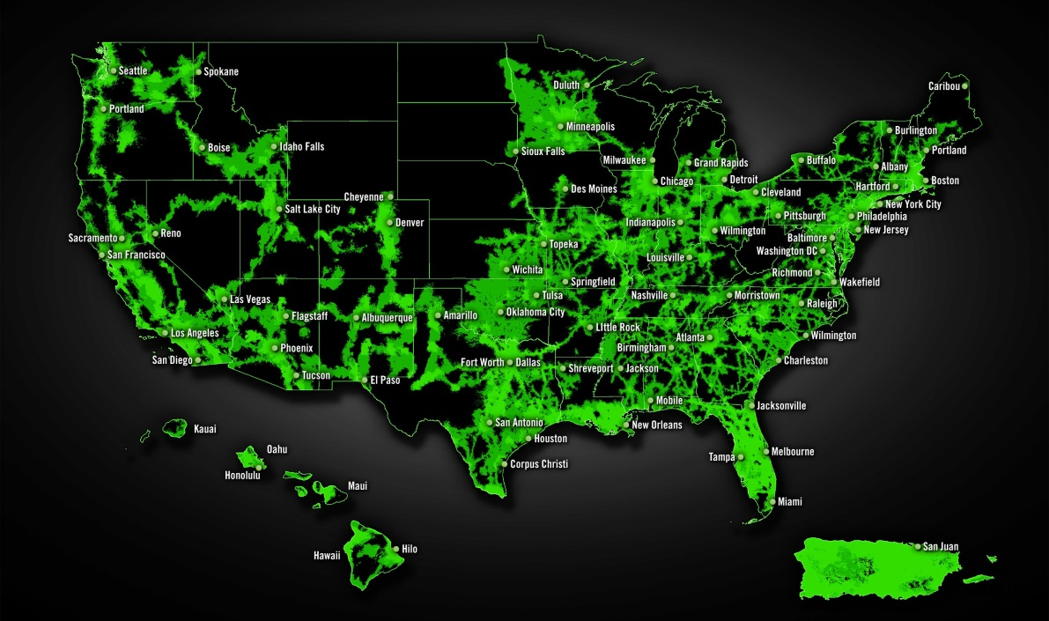

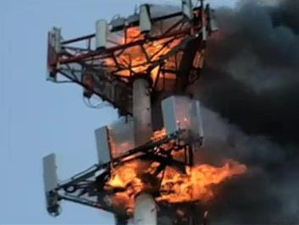
Difficult to interpret at this time
Cellular vs. DSRC
  Cellular 4G is advancing
  LTE-direct

Slide 24
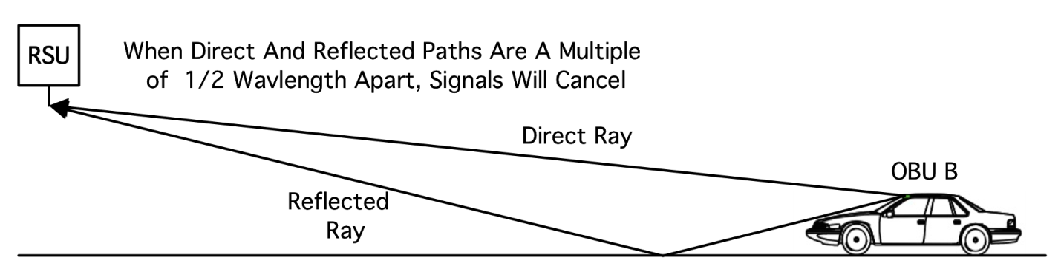
Common Considerations to Concepts
DSRC siting
  7.5m max RSU height
  Non-diversity, multi-path signal fade 200-300m

Slide 25
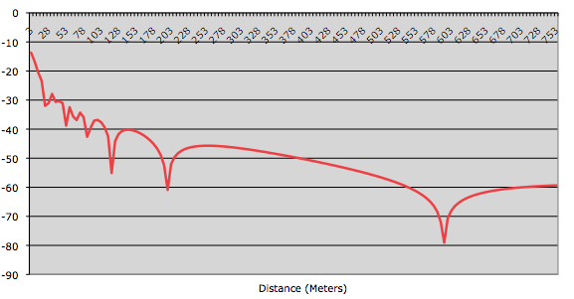
Common Considerations to Concepts

Slide 26
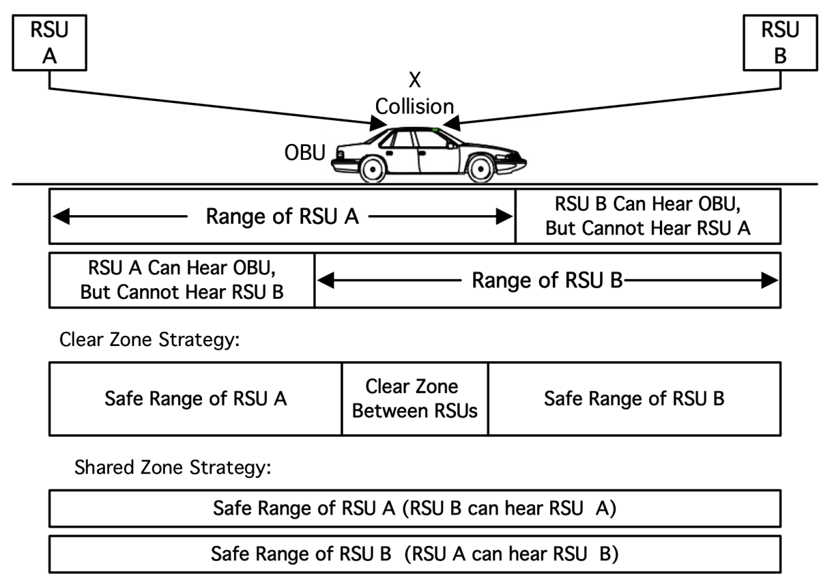
Common Considerations to Concepts
Hidden terminal (CSMA collision)
  Carrier Sense Multiple Access
  sufficient clear zone OR
  RSEs can hear each other

Slide 27
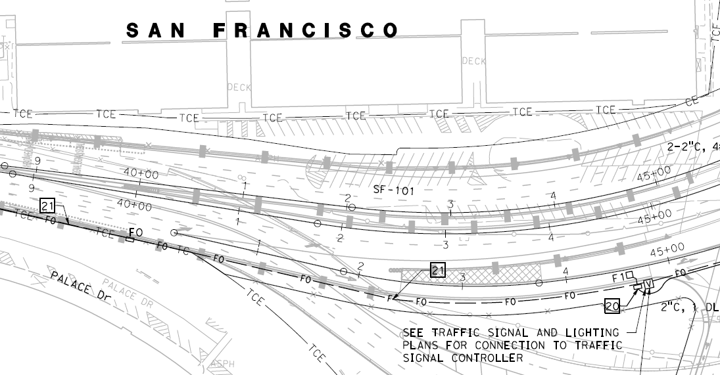
Common Considerations to Concepts
Mapping
  Mobility - Road network & geometric intersection description (GID) – 10 m
  Safety - Dynamic, precise – 1 m
    Work zones
    Lane specific

Slide 28
Deployment Scenarios

Slide 29
Scenarios
Illustrate how different agencies would approach deployment within their jurisdictions
Based on agency interviews:
  substantially engaged,
  have some level of deployment planned or in place, or
  no experience

Slide 30
Base Scenario
(assumptions/givens)
NHTSA decision to pursue rulemaking
5850-5925 MHz DSRC spectrum stays
Technical standards specify:
  DSRC RSE form/fit/function
  OBE function
  interfaces and messages between vehicles and infrastructure
  interfaces and messages between the roadside infrastructure and network information services.

Slide 31
Base Scenario
(assumptions/givens)
Automakers and AASHTO agree on a base set of capabilities
DSRC
  equipment certification capabilities
  certified RSEs in technical compliance
Security Certificate Management System (SCMS) is available
4G LTE services continue to expand
Current trend of automated vehicles continues

Slide 32
The Deployment Scenarios
Urban
Rural
Multi-state
DOT’s
CVO & Frieght
International Land Border

Slide 33
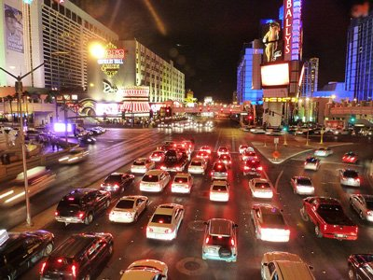
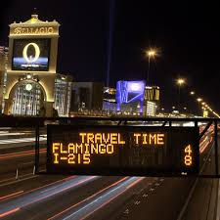
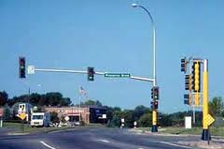
Urban Scenario Characteristics
Highest traffic volume
Largest concentration of deployment
Greater interaction with existing ITS
MPO programming
Greatest ROI – higher value to P3

Slide 34
Urban Scenario Applications
Origin-Destination
ATM
ATMS
Motorist Advisories and Warnings
Multimodal ITS
Arterial Management and Operations
Advanced Signal Operations
Dynamic Transit Operations
Eco-Signal Operations
Dynamic Eco-Routing
Dynamic Multimodal Operations

Slide 35
Rural Scenario Characteristics
More rural roadway and accounts for highest fatalities
Road Ownership | Public Road Length, miles (1) |  |  | Vehicle Miles Traveled, millions (2) | Category Average Daily Traffic
 | Federal Aid Highway | Non-Federal Aid | Total Length
Rural | 681,116 | 2,300,797 | 2,981,913 | 974,038 | 895
Small Urban | 66,889 | 134,188 | 201,077
Urbanized | 249,942 | 496,493 | 746,435
Total Urban | 316,831 | 630,681 | 947,511 | 1,972,094 | 5702
Total Rural and Urban | 997,947 | 2,931,478 | 3,929,425 | 2,946,131 | 2054
Source: FHWA

Slide 36
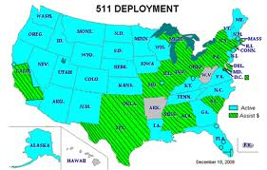
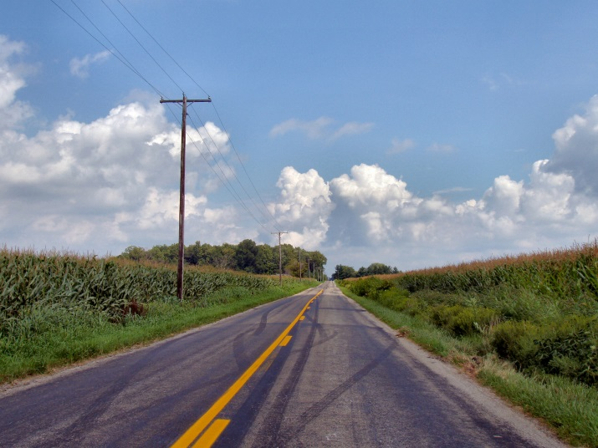
Rural Scenario Characteristics
Most likely statewide deployment
Connected vehicle capabilities addresses limitations with traditional ITS
Lower # of RSE interactions
Cellular favored
Lower ROI

Slide 37
Rural Scenario Applications
Motorist Advisories and Warnings
Stop Sign Assist
Intersection Violation Warnings
Reduced Speed Work Zone Warnings

Slide 38
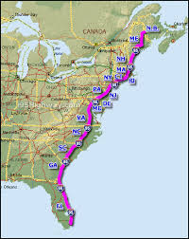
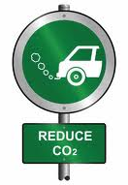
Multi-State Corridor Scenario Characteristics
High passenger or commercial vehicle travel
Increased VMT & interstate delay
Congestion without offsetting capacity
High fuel consumption and GHG
Challenges in coordinated response to incidents

Slide 39
Multi-State Corridor Scenario Applications
Same as urban/rural
Truck e-permitting verification and roadside inspection
Truck e-screening and virtual weigh stations
Smart truck parking
Enhanced maintenance decision support systems
Work zone traveler information

Slide 40
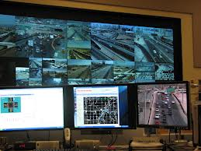
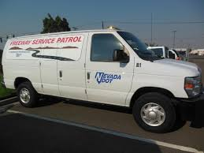
DOT System O&M Scenario Characteristics
Small spheres of deployment
Can offer alternative to legacy systems
Fleets = 1.5% of vehicles
Light vehicles as probes
Heavy vehicles as customized use
Operations vs capital focus

Slide 41
DOT System O&M Scenario Applications
Enhanced Maintenance Decision Support System
  Winter road treatment and snow plowing
  Non-winter maintenance
Information for Maintenance and Fleet Management Systems
Probe-based Pavement Maintenance
Work Zone Traveler Information

Slide 42
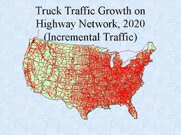
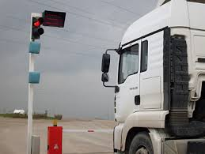
CVO & Freight Scenario Characteristics
Truck traffic expected to increase
High enforcement need
High communication need
Existing RFID technology
Connected vehicle can significantly reduce costs
High private interest
Good pilot candidate

Slide 43
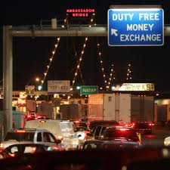
International Border Crossing Scenario Characteristics
All have bottlenecks
Impediment to economic competitiveness
Top 5 handle 25% of US Int’l Merch Trade
Legacy communication infrastructure helpful
Demand management
Federal funding required

Slide 44
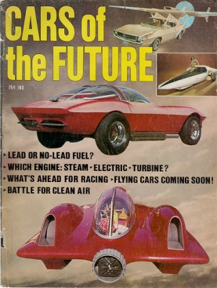
70% market – road configuration changes
Looking ahead
Expanding the field
30% market
2015-2019 2020-2023 2023 2024-2029 2029 2030
Taking solutions to market
Growing to reach demand
Connected vehicles everywhere
Source: AASTHO

Slide 45
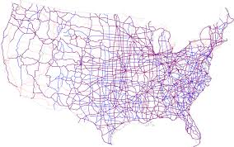

Final step in study
Create a national blueprint
Bigger considerations:
  NHTSA – yes vs. no
  Public, private, P3 investment
  Specific fed funding in T-bill?

Slide 46

http://ssom.transportation.org/Pages/Connected-Vehicles.aspx
Brian Burkhard, PE
Brian.burkhard@transpogroup.com
(415) 747-1008
What Transportation can be

