Slide 1
HCM – Sixth Edition
What’s New in the HCM Sixth Edition
October 19, 2016

Slide 2
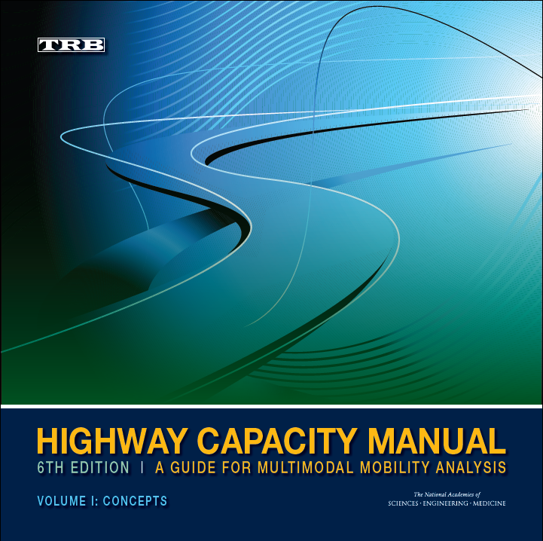
Presentation Overview
Need for an Updated HCM
HCM Structure
Information Presentation
Changes
New Capabilities
Notes:
The structure of today’s briefing parallels the learning objectives we just covered. I will start by discussing the need for an updated HCM.
[Replace placeholder with an image of the HCM 6th edition cover]

Slide 3
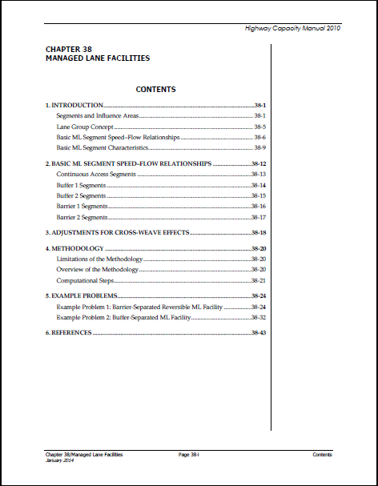
Post-2010 Emerging Topics Chapters
After HCM 2010 was published,
four emerging topics chapters
(35–38) were released online
  Active Traffic and Demand
  Management (ATDM) update
  (Ch. 35)
  Travel time reliability (Ch. 36, 37)
  Managed lanes (Ch. 38)
Notes:
The creation of online Volume 4 allows the HCM to be updated more quickly after research is completed, compared to the typical minimum 10-year wait for a new edition. Four such chapters were released online in 2014. Each chapter was stand-alone and could not be used in conjunction with other new material (e.g., reliability of managed lanes).

Slide 4
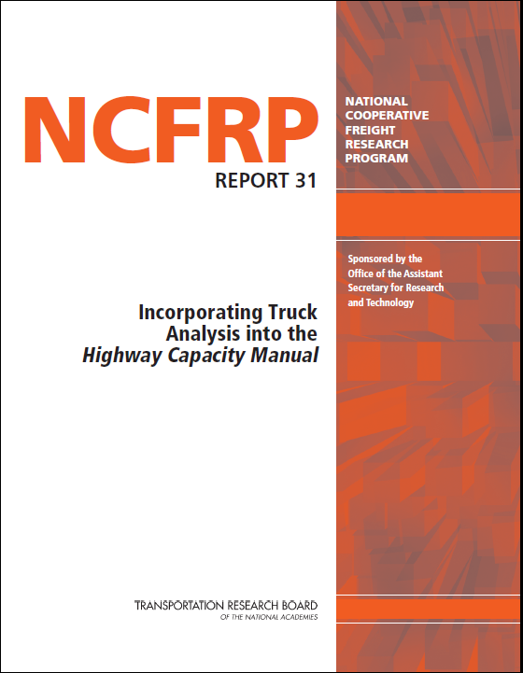

New Research Since HCM 2010
NCFRP 41: truck analysis
NCHRP 03-96: managed lanes
NCHRP 03-100: roundabouts in corridors
NCHRP 03-107: work zone capacity
NCHRP 03-115: HCM production
NCHRP 07-22: planning guide to HCM
SHRP 2 L08: travel time reliability
FHWA: ATDM, roundabouts,
alternative intersections
Notes:
Several million dollars in new research has been performed since HCM 2010 was published. Some of these projects introduce new capabilities to the HCM: analyzing managed lane and work zone operations, measuring and predicting travel time reliability, analyzing alternative intersection forms, and evaluating roadway corridors incorporating a series of roundabouts. Some projects update previous research to account for driver behavior and technological changes: truck analysis, roundabouts, and Active Traffic and Demand Management (ATDM). Finally, some projects have focused on enhancing how all of this new and existing information can be effectively communicated to HCM users. Later in the presentation, we will go into more detail about how this research has been incorporated into the HCM.

Slide 5
Need for an Updated Title
Over the years, HCM content has
expanded considerably beyond
simply “highway capacity”
  Multiple performance measures
  Many facility types
  Multimodal analysis
Transportation professionals
and decision-makers have not
always been aware of these
additional features
ITE Journal, February 2015
Notes:
In addition to the need to integrate new content into the HCM, the need for a title more descriptive of the HCM’s contents was becoming more apparent. The HCM’s content has evolved to keep pace with the analysis needs of transportation professionals, but the basic title has stayed the same since 1950. Transportation professionals and decision-makers have not always been aware of the features that have been added over time.

Slide 6
HCM Sixth Edition
Previous HCM editions have had a year attached
Looking forward, it is likely that chapters will continue to be released or updated as new research is completed, rather than waiting for a critical mass to accumulate
  Two-lane highway update
  Advances in ATDM
  Connected and autonomous vehicles
Each chapter will have its own version number, allowing chapters to be updated independently
Notes:
Previous HCM editions have had a year in the title, although they’ve also been referred to as an ”edition” somewhere inside. It has become increasingly impractical to wait 10-15 years for new research to be completed to issue a new HCM and the online Volume 4 introduced with HCM 2010 facilitates issuing new and updated chapters. Each chapter will have its own version number, starting with 6.0, which will be updated as errata are released and as new research is incorporated. This approach will allow the HCM to continue to present state-of-the-art methods, while allowing analysts to tie their analysis to a specific version of a methodology.

Slide 7
Presentation Overview
Need for an Updated HCM
HCM Structure
Information Presentation
Changes
New Capabilities
Notes:
We will now move on to today’s second topic: the structure of the HCM 6th Edition.
[Replace placeholder with an image of the HCM 6th edition cover]

Slide 8
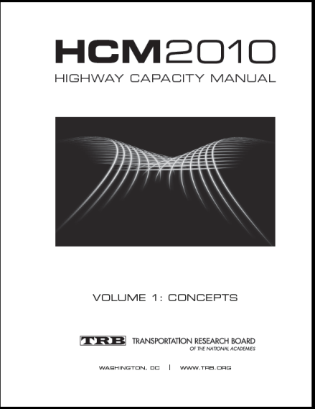
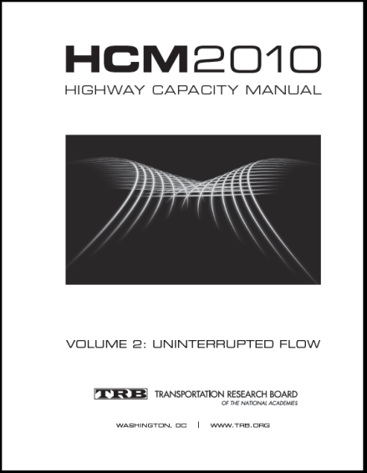
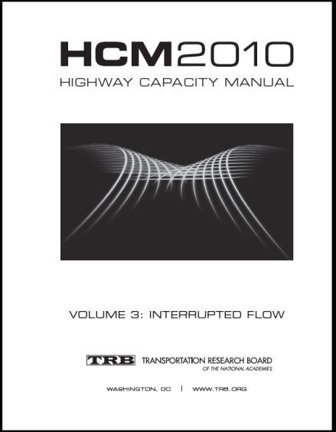
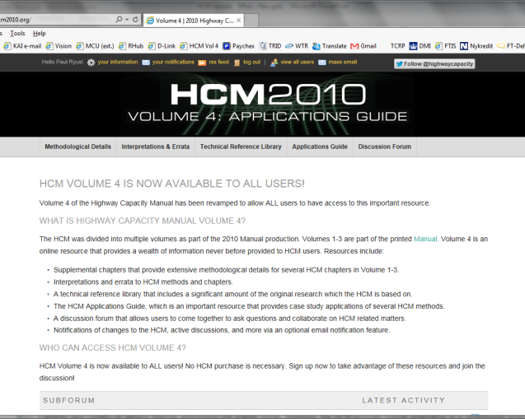
HCM Structure
Printed HCM
Online
Volume 1:
Concepts
Volume 2:
Uninterrupted Flow
Volume 3:
Interrupted Flow
Volume 4:
Applications Guide
Notes:
The HCM is divided into four volumes: three printed and one online. Volume 1 houses concepts material that all HCM users should be familiar with before applying the HCM. Volume 2 describes the methodologies for freeways and highways, while Volume 3 describes the methodologies for urban streets and off-street pedestrian and bicycle facilities. Volume 4 provides additional resources that support the material in the printed HCM. We’ll briefly go through the contents of each of these volumes in the next few slides. Later in the presentation, we’ll go over the changes in these chapters.
[Replace graphics with Sixth Edition versions when available]

Slide 9
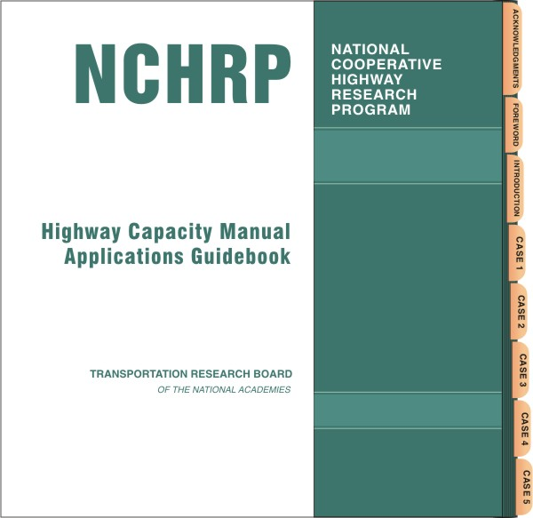
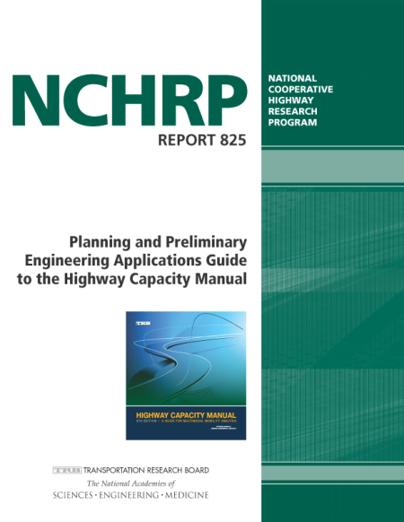
Other Volume 4 Features
Interpretations and errata
Technical reference library
Applications guides
  HCM Applications Guidebook
  Planning & Preliminary
  Engineering Applications
  Guide to the HCM
Discussion forum
Notes:
Volume 4 provides more than just access to supplemental chapters. TRB’s Highway Capacity Committee periodically issues interpretations and errata for the HCM that result from user questions and feedback; these are posted in Volume 4. The technical reference library provides access to many of the source research reports that form the basis for HCM methods. The HCM Applications Guidebook is an online tool that demonstrates how the HCM can be applied to a project as it evolves from concept to design to implementation. The new Planning & Preliminary Engineering Applications Guide, the subject of a future briefing in this series, demonstrates how HCM concepts and methods can be incorporated into planning-level evaluations. Finally, a discussion forum allows HCM users to ask questions of the broader HCM community on the use of the HCM, and to provide feedback about the HCM.
[Replace placeholder with PPEAG cover when available]

Slide 10
Presentation Overview
Need for an Updated HCM
HCM Purpose and Structure
Information Presentation
Changes
New Capabilities
Notes:
Next, we will review changes to the way information is presented to the reader in the HCM.
[Replace placeholder with an image of the HCM 6th edition cover]

Slide 11
HCM Presentation Changes
Additional changes have been made for
the HCM Sixth Edition
  Standardized chapter outlines
  Presentation of the core chapter methodology, followed by extensions
  Summary tables listing data requirements, potential data sources, suggested default values, and sensitivity of results to inputs
  Example results in many chapters
  Example problems moved to Volume 4
Notes:
The HCM Sixth Edition continues the evolution of how HCM information is presented to better serve the needs of today’s users. As will be described in a moment, methodological chapter outlines have been standardized. Summary tables are provided that list data requirements, potential data sources, suggested default values, and the sensitivity of results to particular inputs. Example results in many chapters allow analysts to check the reasonableness of their results. To make room for new content, example problems showing step-by-step calculations have been moved to the supplemental chapters in Volume 4.
[Replace placeholder with HCM Sixth Edition cover]

Slide 12
Presentation Overview
Need for an Updated HCM
HCM Purpose and Structure
Information Presentation
Changes
New Capabilities
Notes:
The final portion of this briefing will introduce the new analysis capabilities provided by the HCM Sixth Edition. The other briefings in this series will provide details about these new capabilities.
[Replace placeholder with an image of the HCM 6th edition cover]

Slide 13
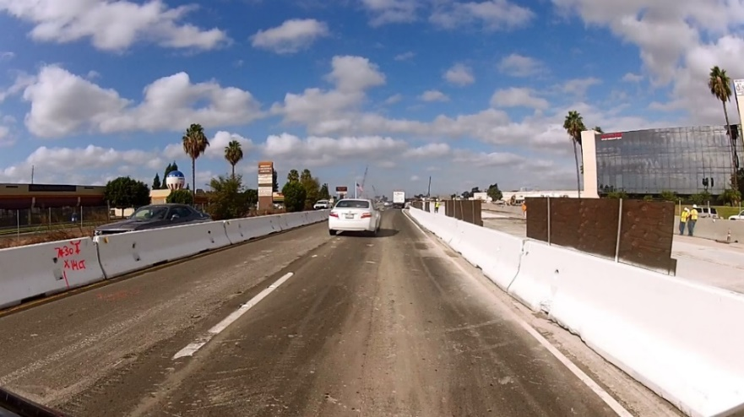
Freeway Facilities
Core method described in Chapter 10
  New freeway work zone method
  New managed lanes method
  New research on truck effects on freeway operations
  Guidance on evaluating ATDM strategies on typical-day freeway operations
  Improved guidance on segmenting freeways and matching section data from external databases to HCM segments
Notes:
A number of new capabilities have been added to Chapter 10 as a result of new research, including methods to analyze freeway work zones and managed lanes, including interactions between managed lanes and general-purpose lanes. Truck effects are discussed in Chapter 12 in the context of freeway segments, but carry over into a facilities analysis. Similarly, ATDM strategy evaluation is discussed in Chapter 12 in the context of a reliability analysis, but Chapter 10 provides guidance on evaluating the effects of these strategies on typical-day (average) freeway operations. Finally, in light of the increasing availability of freeway travel time data from commercial providers, Chapter 10 provides guidance on matching those databases’ sections to HCM segments.

Slide 14
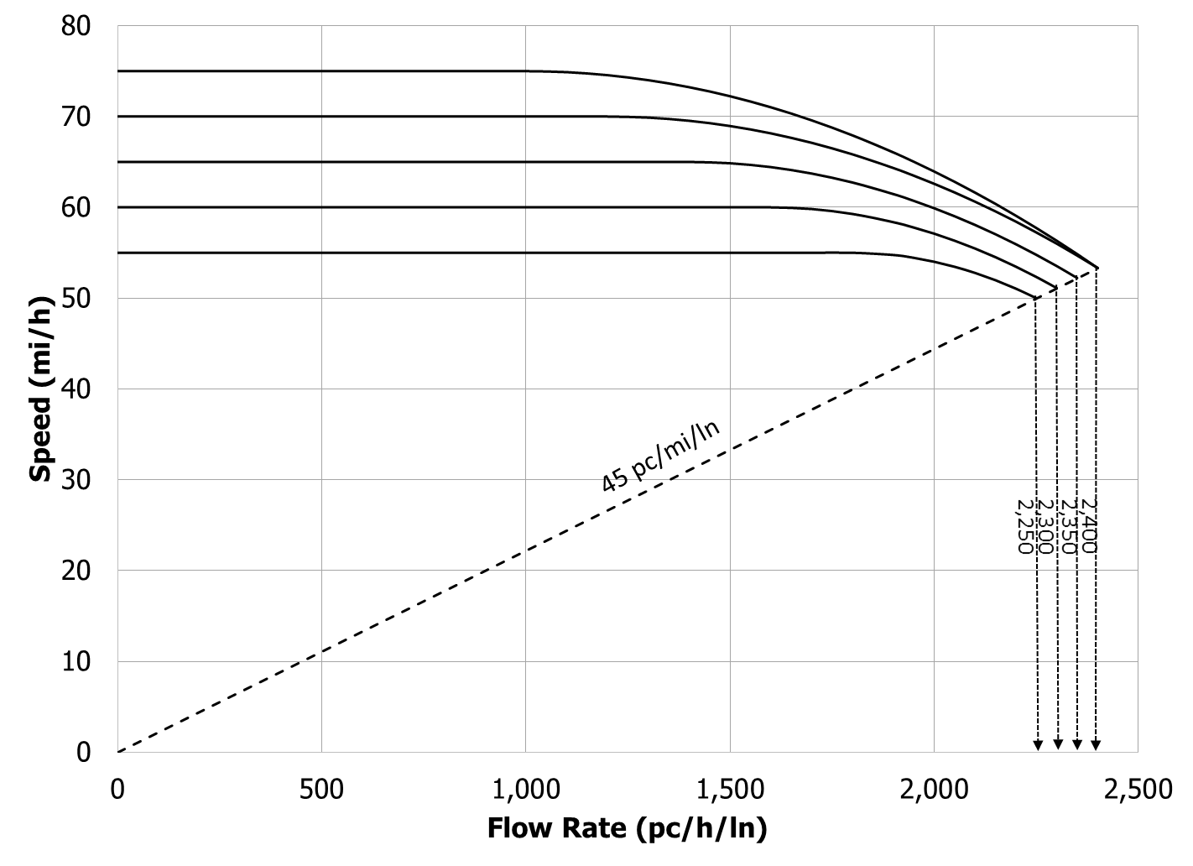
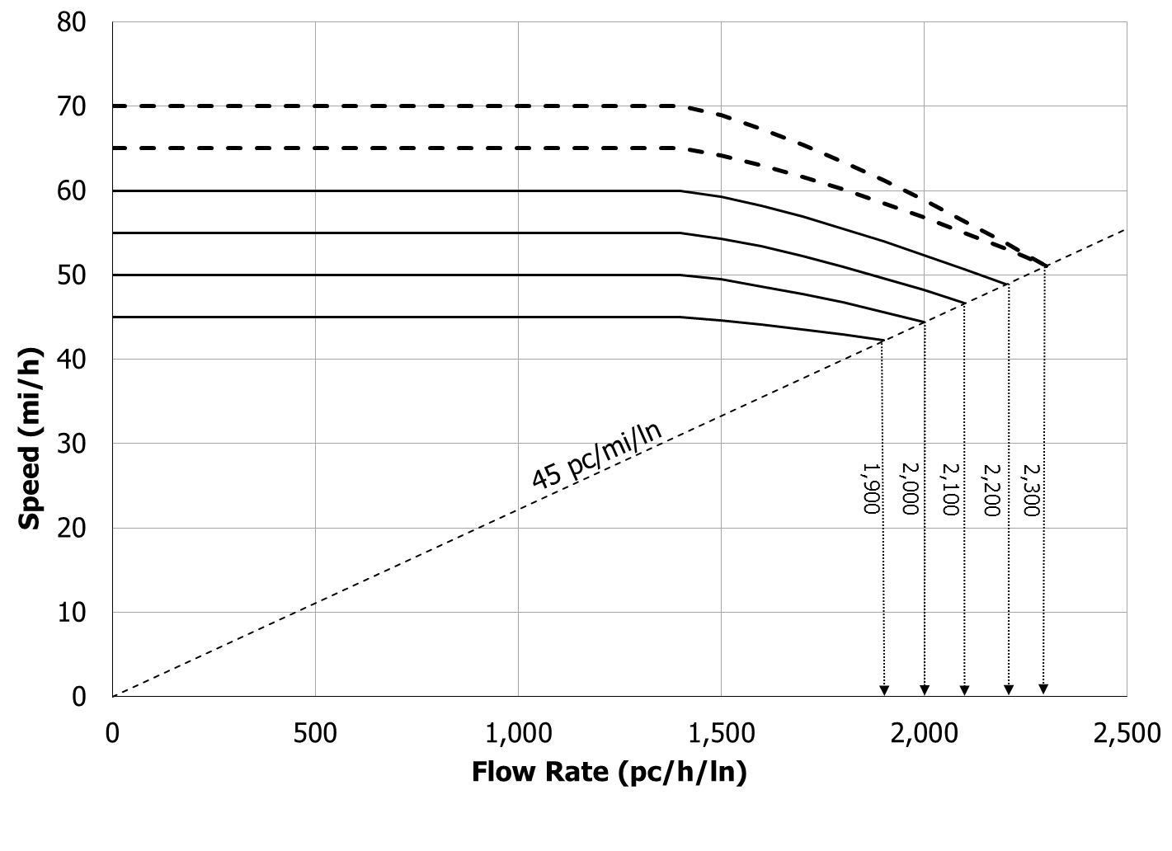
Freeway/Multilane Highway Segments
Chapter 12 merges the previous individual chapters on basic freeway segments and multilane highways
Uses one unified speed–flow equation applicable to both freeway and multilane highway segments, but the forms of the curves are different
  Freeways Multilane highways
Notes:
Because the basic methods for evaluating freeway and multilane highway segments are very similar, they have been merged into one chapter for ease of presentation. Factors that distinguish multilane highway operation from freeway operation are still accounted for. To facilitate the integration of the new reliability, managed lanes, and work zone methods, a unified speed-flow equation has been developed applicable to both freeway and multilane highway segments.
Other notable changes in Chapter 12 include updated truck passenger car equivalency tables, based on new research. Capacity and speed adjustment factors (CAFs and SAFs) are now the primary way of making adjustments to the speed-flow curve. Changes to the multilane highway method include a slightly increased density at capacity and speed-flow curves for multilane highways with 65 and 70 mi/h free-flow speeds.

Slide 15
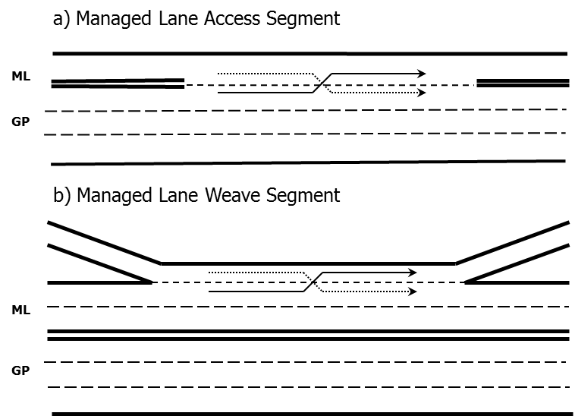
Freeway Weaving
Chapter 13 integrates material on managed lane weaving sections and cross-weave effects in the general-purpose lanes
Emphasis on the use of CAFs and SAFs for calibration
Chapter 27 provides new example problems demonstrating the new capabilities
Notes:
Managed lane weaving has been incorporated into Chapter 13, both in terms of the actual interface between the managed and general-purpose lanes, and in terms of cross-weave effects, where vehicles weave across the general-purpose lanes after entering the freeway or in preparation for exiting the freeway.

Slide 16
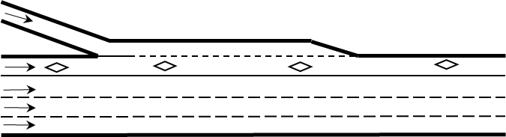
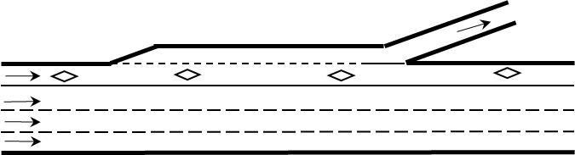
Freeway Merges and Diverges
Chapter 14 integrates material on managed lane merges and diverges
New guidance on aggregating densities in segments with 3+ lanes
Emphasis on the use of CAFs and SAFs for calibration
Chapter 28 provides new example problems demonstrating the new capabilities
Notes:
Managed lane merge and diverge analysis procedures have been incorporated into Chapter 14. The chapter provides new formalized guidance for aggregating merge and diverge segment densities for segments with three or more lanes.

Slide 17
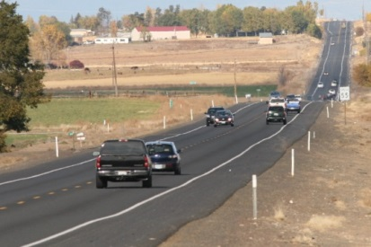
Two-Lane Highways
No significant changes to the method
New guidance on applying the method and interpreting its results
Clarified that certain calculation steps need not be skipped if the performance measure being calculated is of interest to the analysis
Chapter anticipated to be
updated in a few years as a
result of ongoing research
Example problems moved to
Chapter 26
Notes:
No significant changes have been to the method, but additional guidance has been provided. In addition, some calculation steps that previously were always skipped (because they weren’t needed to calculate LOS for a particular two-lane highway class) have been made optional, to clarify that they can be applied if the user is interested in determining the performance measure calculated by that step. NCHRP Project 17-65, currently ongoing, is expected to produce an updated chapter within the next few years. This chapter’s example problems now appear in Chapter 26.

Slide 18
Urban Street Facilities
Service measure changed to average travel speed from average travel speed as percent of free-flow speed
LOS A/B threshold lowered to the equivalent of
80% of free-flow speed
New method for evaluating spillback
Pedestrian and bicycle LOS now weighted by travel time instead of length
Example problems moved to Chapter 29
LOS | Travel Speed Threshold by Base Free-Flow Speed (mi/h) |  |  |  |  |  |  | Volume-to-Capacity Ratioª
 | 55 | 50 | 45 | 40 | 35 | 30 | 25
A | >44 | >40 | >36 | >32 | >28 | >24 | >20 | ≤ 1.0
B | >37 | >34 | >30 | >27 | >23 | >20 | >17
C | >28 | >25 | >23 | >20 | >18 | >15 | >13
D | >22 | >20 | >18 | >16 | >14 | >12 | >10
E | >17 | >15 | >14 | >12 | >11 | >9 | >8
F | ≤17 | ≤15 | ≤14 | ≤12 | ≤11 | ≤9 | ≤8
F | Any |  |  |  |  |  |  | > 1.0
Notes:
Chapter 16’s service measure has changed to average travel speed, to be more intuitive to practitioners. This change is not intended to affect a facility’s LOS result, although analysts may nevertheless see up to a one-letter LOS change when the facility operated close to a LOS threshold, due to calculation rounding effects. Another change that does affect LOS is that the LOS A/B threshold has been reduced from the equivalent of 85% of free-flow speed to 80%, to better reflect the real-world distribution of service levels among urban street segments. A procedure has been added for evaluating facilities that include segments experiencing sustained spillback. Pedestrian and bicycle LOS is now weighted by link travel time instead of link length, to reflect the amount of time these modes experience conditions on the link. Finally, example problems have been moved to Chapter 29.

Slide 19
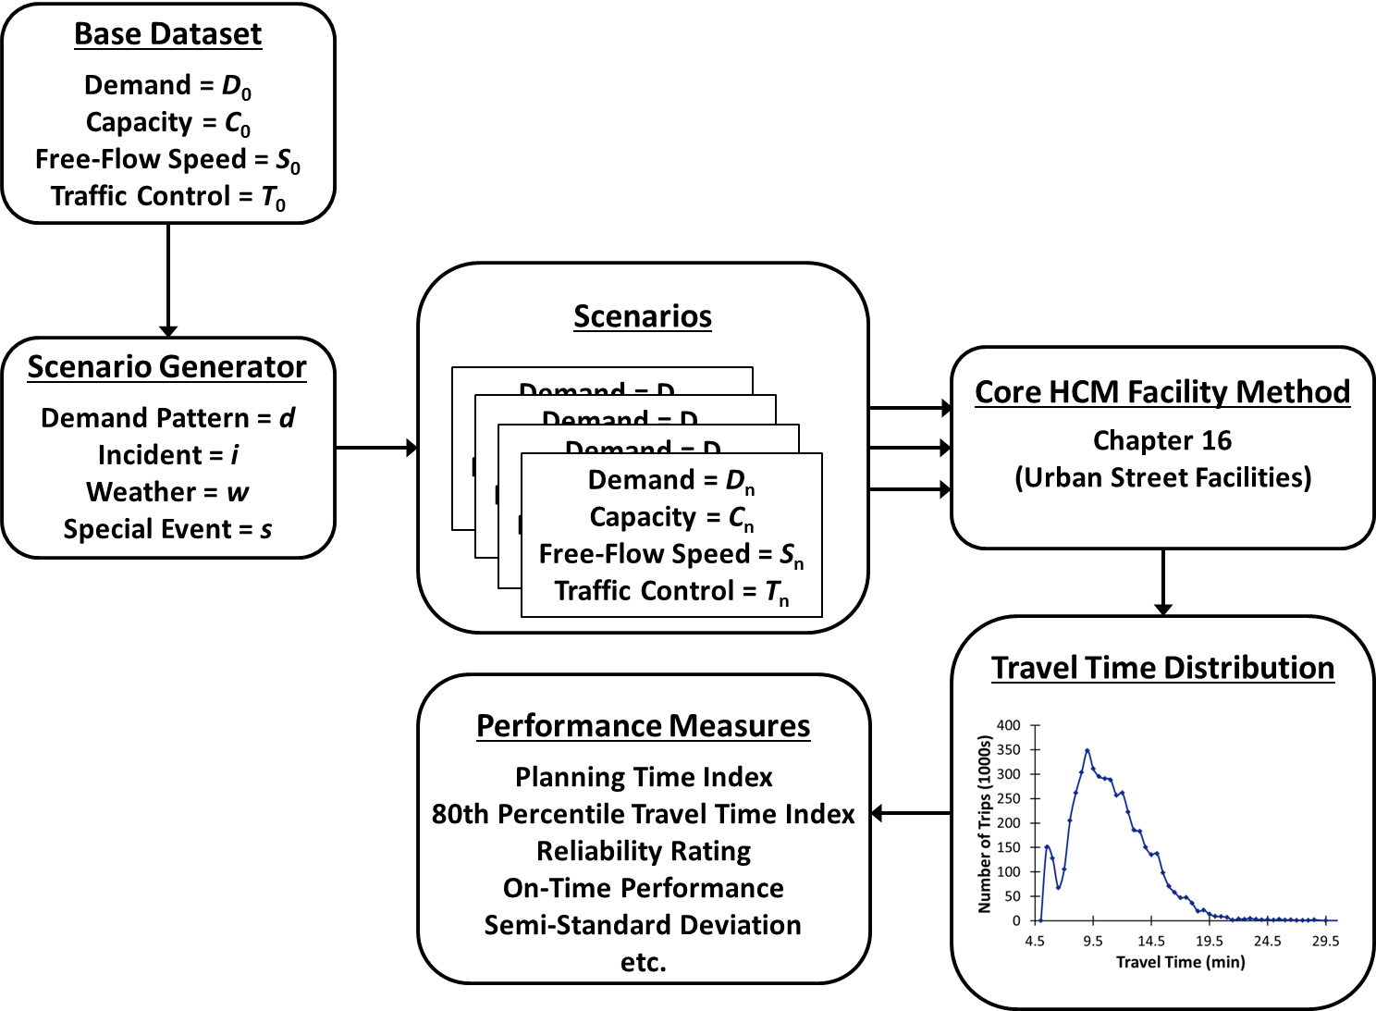
Urban Street Reliability and ATDM
New Chapter 17
  Integrates material previously appearing in Chapter 35 and interim Chapters 36 and 37
Reliability calculation
process similar to that
used for freeway
reliability analysis
  Repetitive application
  of Chapter 16 core method
  with varying inputs
New guidance on analyzing ATDM strategies
Notes:
Chapter 17 is a new chapter that integrates the ATDM material previously found in Chapter 35 and the urban street travel time reliability material previously found in interim Chapters 36 and 37. Similar to freeway reliability analysis, the urban street reliability method repeatedly applies the core Chapter 16 facility method with varying demands, capacities, free-flow speeds, and number of lanes that reflect the variations in demand and the effects of severe weather, incidents, work zones, and special events over a long timeframe (up to a year). As was the case with freeway reliability analysis, the urban street reliability method can only practically be implemented through software. Chapter 17 also provides new conceptual information about ATDM and techniques to evaluate ATDM strategies.

Slide 20
Urban Street Segments
Same service measure changes as described for urban street facilities
New method for evaluating segments with midsegment lane blockage
Improved procedure for predicting segment queue spillback time
New adjustment factor for parking activity that affects free-flow speed estimation
Notes:
As was the case with urban street facilities, the urban street segment service measure has been changed to average travel speed, and the LOS A/B threshold has been reduced to the equivalent of 80% of free-flow speed. New and improved methods include the capability to evaluate segments with midsegment lane blockage, an improved procedure for predicting segment queue spillback time, and a new adjustment factor for parking activity that affects free-flow speed estimation.

Slide 21
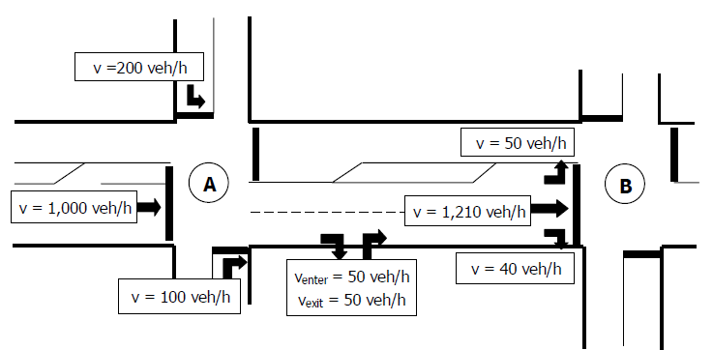
Urban Street Segments
Procedure can now evaluate segments with roundabouts at one or both ends
Right-turn-on-red
vehicles incorporated
into volume-balancing
method for flows into
and out of a segment
Pedestrian and bicycle LOS scores now use time-based weighting
Changes to bicycle and bus default values
Notes:
Other new capabilities are listed here. The unsignalized conflicts factor term for the bicycle mode has been revised to consider 20 conflict points per mile as the base (no-effect) condition, rather than 0 conflict points per mile. The default bus acceleration rate has been revised.

Slide 22
Signalized Intersections
Delay of unsignalized movements can now be considered (user-supplied input)
Combined saturation flow adjustment factor for heavy vehicles and grade
New saturation flow adjustment factors for intersection work zone presence, midsegment lane blockage, and downstream spillback
Notes:
In Chapter 19, the delay of unsignalized movements at a signalized intersection can now be considered when calculating approach and intersection delay. The user must supply these delay values. The previous individual saturation flow adjustment factors for heavy vehicles and grade have been combined into a single factor. New saturation flow adjustment factors are provided to account for the effects of a work zone at the intersection, lane blockage upstream of the intersection, and sustained spillback from the downstream segment.

Slide 23


Stop-Controlled Intersections
No significant changes in the two-way and all-way stop methods
Clarified how the peak hour factor is applied
Example problems moved to Chapter 32
Notes:
There are no significant changes to the stop-controlled intersection methods, although the use of the peak hour factor has been clarified.

Slide 24
Roundabouts
Capacity models have
been updated as a result
of new research
New calibration
procedure provided
Clarified how the peak
hour factor is applied
Example problems moved to Chapter 33
Notes:
New FHWA-sponsored research has resulted in updated capacity models that provide higher roundabout capacities than previously given in the HCM. This is thought to be primarily due to the fact that more roundabouts—and, particularly, more saturated roundabout approaches—exist now than when the original US research was conducted, allowing for the development of a richer database of roundabout operations than was previously possible. Roundabout capacities vary widely across the US, and a method is provided for calibrating roundabout capacities to existing conditions.

Slide 25
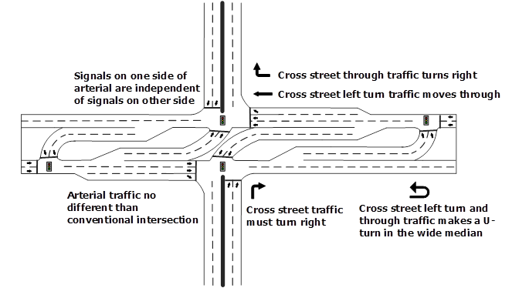
Ramp Terminals and Alternative Intersections
The former Interchange Ramp Terminals chapter has been expanded to include a greater variety of distributed intersections
  Two or more intersections with close spacing and displaced or distributed traffic movements that are operationally inter-
  dependent and are best
  analyzed as a single unit
Notes:
Chapter 23 now covers both interchange ramp terminals and alternative intersection forms. It is divided into three parts: distributed intersection concepts, interchange ramp terminal evaluation, and alternative intersection evaluation.

Slide 26
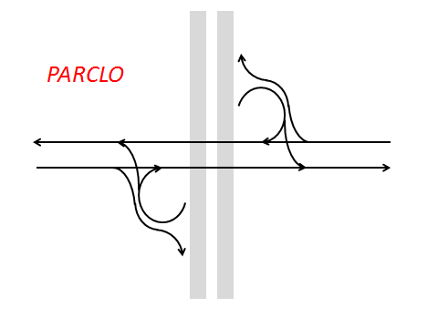
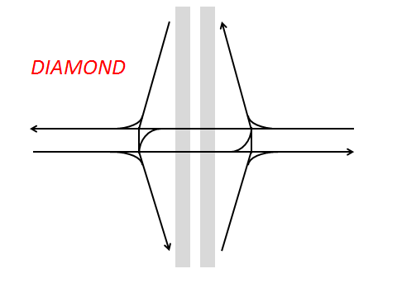
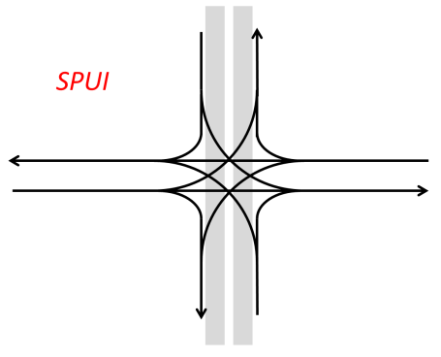
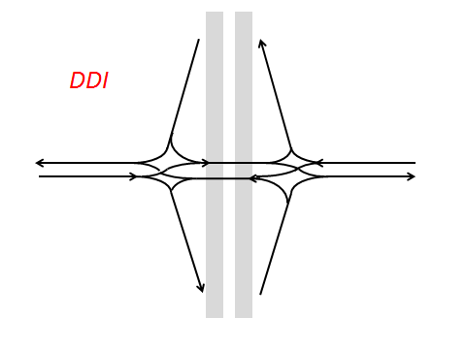
Ramp Terminal Forms Addressed
Notes:
The interchange ramp terminal forms addressed in Chapter 23 are the different varieties of partial cloverleaf, diamond, single point urban, and diverging diamond interchanges.

Slide 27
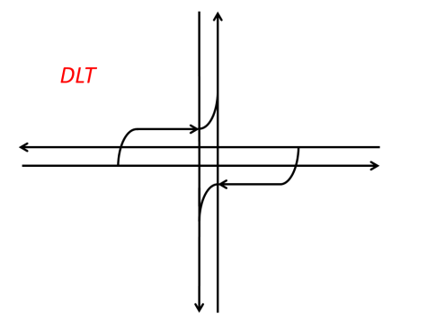
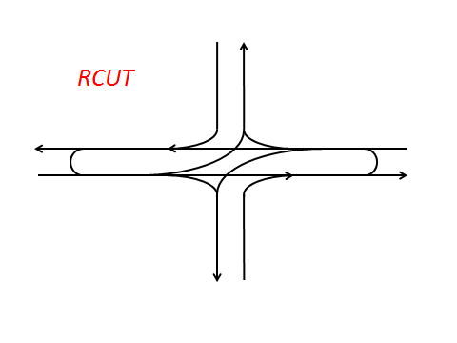
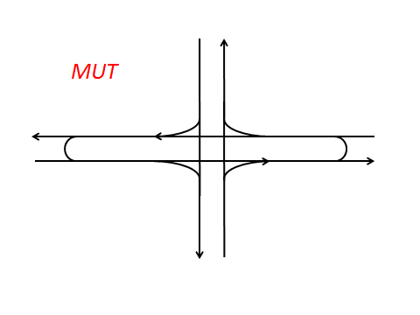
Intersection Forms Addressed
Notes:
The distributed intersection forms addressed in Chapter 23 are displaced left-turn, restricted-crossing U-turn, and median U-turn intersections.

Slide 28
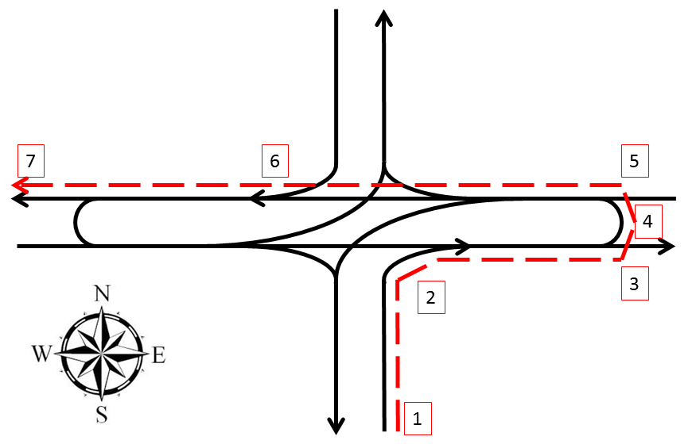
Ramp Terminals and Alternative Intersections
New service measure: experienced travel time
  Sum of control delays at each node and extra distance travel time experienced by rerouted movements
New and updated example problems are located in supplemental Chapter 34
Notes:
Both ramp terminals and alternative intersections now use a new service measure, experienced travel time, that is intended to allow these intersections’ performance to be compared on an apples-to-apples basis with other intersection forms. Experienced travel time includes the sum of average control delays experienced by a given movement, plus any extra distance travel time the movement may experience as a result of being rerouted.

Slide 29
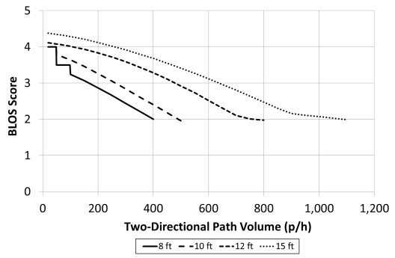
Off-Street Pedestrian and Bicycle Facilities
No significant changes to the methods
Some variable names and equations have been changed to improve their understandability without affecting results
Additional guidance
provided on applying
the methods and
interpreting results
New Chapter 35
houses the example
problems
Notes:
No changes have been made to the off-street pedestrian and bicycle facility calculations found in Chapter 24, although some changes have been made to improve user understanding of the methods, such as graphs similar to the one shown here that demonstrates how the bicycle LOS score for a shared off-street path is influenced by path width and two-directional path volume.

Slide 30

Questions?
Questions
  Note that details about many of
  these new capabilities will be
  covered in subsequent web briefings
Notes:
This concludes the section on New Capabilities. Let’s take a few minutes to answer some questions.

Slide 31
Introduction to the Planning & Preliminary Engineering Applications Guide to the HCM
October 19, 2016
Notes:
Today’s web briefing introduces the Planning & Preliminary Engineering Applications Guide to the Highway Capacity Manual.

Slide 32
“Planning” in an HCM Context
Planning analyses are generally directed toward broad issues
  Initial problem identification, long-range analyses, statewide performance monitoring
Preliminary engineering analyses support moderately detailed issues
  Planning decisions on roadway design concept and scope, alternatives analyses, and proposed systemwide policies
Notes:
Before jumping into the presentation, it will be useful to define what planning and preliminary engineering is in an HCM context.
In an HCM context, planning analyses are generally directed toward broad issues that involve analyzing a large number of facilities. The purpose of the analysis may be to identify facilities that may have existing or future operational issues and require more a detailed analysis. In this case, HCM methods are used to screen out facilities that are unlikely to have problems, allowing analysis resources to be focused on the potential problem areas. HCM planning analysis techniques are also applicable to statewide performance monitoring, where the performance of a large number of facilities needs to be summarized.
Preliminary engineering analyses support moderately detailed issues, such as identifying the required number of lanes to provide a given level of service and conducting a more-detailed analysis of a limited set of alternatives. These types of analyses can also investigate the potential effects of proposed systemwide policies such as lane use control for heavy vehicles, systemwide freeway ramp metering and other intelligent transportation system applications, and the use of demand management techniques.
The HCM also defines ”design” and ”operations” levels of analyses that are more detailed and beyond the scope of the Planning & Preliminary Engineering Guide; we’ll cover these briefly later in the presentation.

Slide 33
Presentation Overview
Need for the P&PE Applications Guide
Guide Scope and Structure
Guide Outline
Notes:
We are now ready to move onto the topic of today’s briefing: Introducing the Planning & Preliminary Engineering Applications Guide to the HCM. For convenience, I will generally refer to the document as the “Guide” from this point on. I will start with a brief overview of why the Guide is needed.

Slide 34
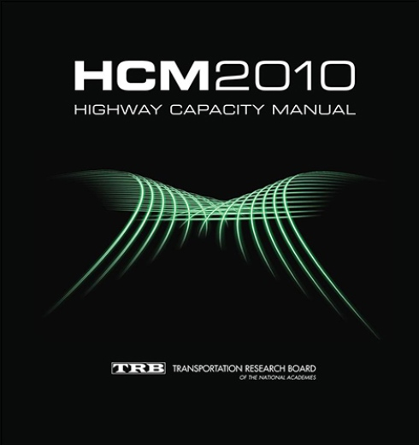
Potential Use of the HCM in Planning
The HCM is commonly used to evaluate current or forecast roadway operations
The HCM can also reliably and
cost-effectively support:
  Planning efforts
  Programming decisions
  Performance monitoring
  Roadway management
Notes:
According to the introduction to the Guide, the Highway Capacity Manual (HCM) is commonly used by transportation agencies to evaluate the current or forecast operations of roadway facilities. Less well known is that the HCM can also be used to cost-effectively and reliably support agencies’ planning, programming, and management decisions.
[Replace image with an HCM 6th Edition cover when available]

Slide 35
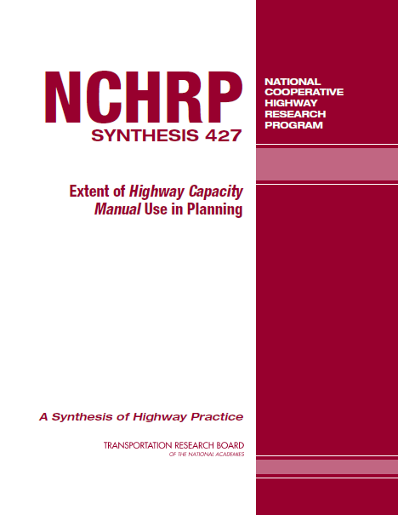
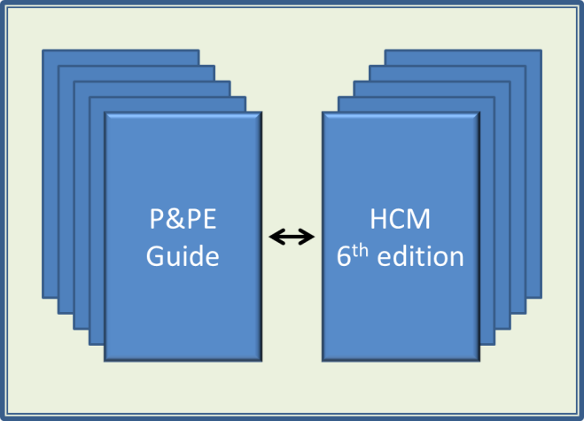
Users’ Desired HCM Improvements for Planning
Develop a P&PE Applications Guide
Provide travel time reliability measures
Extend HCM to system & corridor analyses
Integrate HCM methods better with travel demand models
Provide systemwide MOEs
Notes:
The most-desired HCM improvement among the survey respondents was to develop an applications guide showing how the HCM could be applied to typical planning and preliminary engineering tasks. As discussed in another briefing, the HCM now provides travel time reliability measures. The HCM2000 provided some rudimentrary system and corridor methods, but they required software to be developed to make them practical and therefore received little use and were dropped in the HCM 2010. Other desired improvements included better integration of the HCM with travel demand models and guidance on estimating systemwide measures of effectiveness such as vehicle-hours or person-miles of travel.

Slide 36
Scope of the HCM
The HCM has traditionally focused on describing detailed methods for estimating roadway operational performance
  Concepts
  Step by step computational methods
  Example problems
More limited information and guidance has been available for planning applications
  Default values
  Generalized service volume tables
  Quick estimation methods
Notes:
Throughout its 65-year history, the HCM has focused on describing and demonstrating computational methods for evaluating roadway operations, along with explaining the theoretical concepts underlying the methods. Specific to planning, HCM chapters provides tools such as default values, service volume tables, quick estimation methods, or a combination of these. Although the HCM provides sections in each Volume 2 and 3 chapter outlining HCM methods’ potential use in operations, design, and planning & preliminary engineering applications, the HCM only provides limited guidance on how to apply its methods and tools in the context of a broader decision-making process.

Slide 37
HCM Applications Guidebook
The HCM Applications Guidebook (HCMAG) was developed to meet this need for guidance for operations and design analyses
Still little guidance planning and preliminary engineering analyses
Notes:
To address the need for more guidance on how to apply the HCM in the context of a larger operations or design study, the HCM Applications Guidebook was developed in 2006. This guide is available as part of the online HCM Volume 4.
[Provide link to Volume 4 when the new address is determined]

Slide 38
Objectives for a Planning Guide
The Planning & Preliminary Engineering Applications Guide was developed to address:
  Appropriate use of the HCM to a broad spectrum of planning applications
  Use of default values and other HCM tools
  Use of the HCM in scenario planning
  Coordinated use of HCM with planning models
  Use of the HCM in evaluating oversaturated conditions in a planning context
Notes:
National Cooperative Highway Research Program project 07-22 was funded to develop a Planning & Preliminary Applications Guide to the HCM that would describe how the HCM could be applied to a wide variety of planning, preliminary engineering, and performance management applications, including but not limited to the use of default values and service volume tables; HCM use in scenario planning; HCM use with travel demand, noise, and air quality models; and the evaluation of over-capacity conditions in a planning context.

Slide 39
Presentation Overview
Need for the P&PE Applications Guide
Guide Scope and Structure
Guide Outline
Notes:
We will now move on to today’s second topic: the scope of the Guide and its structure.

Slide 40
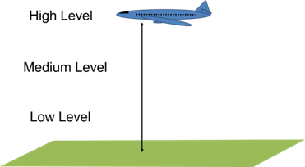
Levels of Planning Analysis
High level
  Large analysis area
  Low detail
Medium level
  Focus on a single roadway
  facility, segment, or
  intersection
  Greater detail
Low level
  Highly focused and highly detailed
Notes:
Planning and preliminary engineering covers a wide spectrum of possible levels of analysis. At the highest level (visualize a plane flying at high altitude), the area covered by the analysis is large, but the degree of detail or precision for any particular segment of road is low. This is a typical characteristic of regional areawide studies and sketch planning and screening studies. Relatively few data inputs (e.g., volume, number of lanes) are used, but the number of roadways to be analyzed can be challenging, and the precision of the results is low. Medium-level analyses, such as typical HCM analyses using a mix of measured and default values, have smaller study areas but require a greater variety of data inputs and the analysis results have a correspondingly higher precision. Microsimulation is an example of a low-level analysis that requires a great deal of time and data, but produces the most detailed results. In general, the level of detail produced by microsimulation is unnecessary for a planning analysis, as many of the data inputs (e.g., future volumes) are not known with great precision.

Slide 41
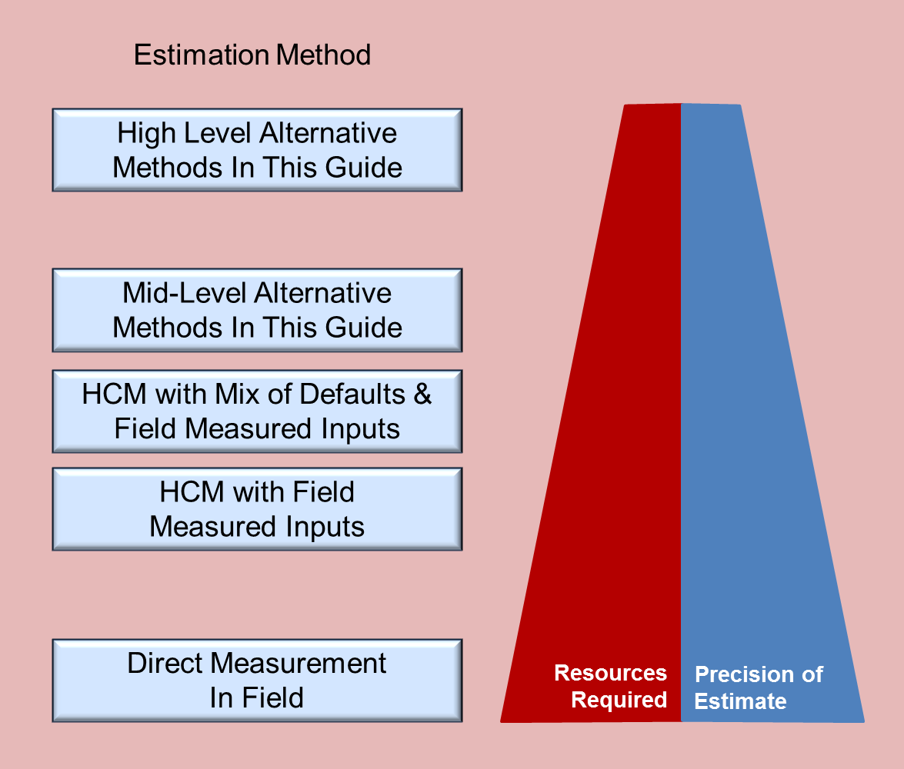
Focus of the Guide
Multi-
facility
Single
facility, point
Notes:
The Guide focuses on mid- and high-level analysis methods that either apply the HCM directly or are “HCM-based”—applying simplifications to a method described in the HCM to make it more usable in a planning context (balancing data needs and computational resources with the required accuracy for an analysis.

Slide 42
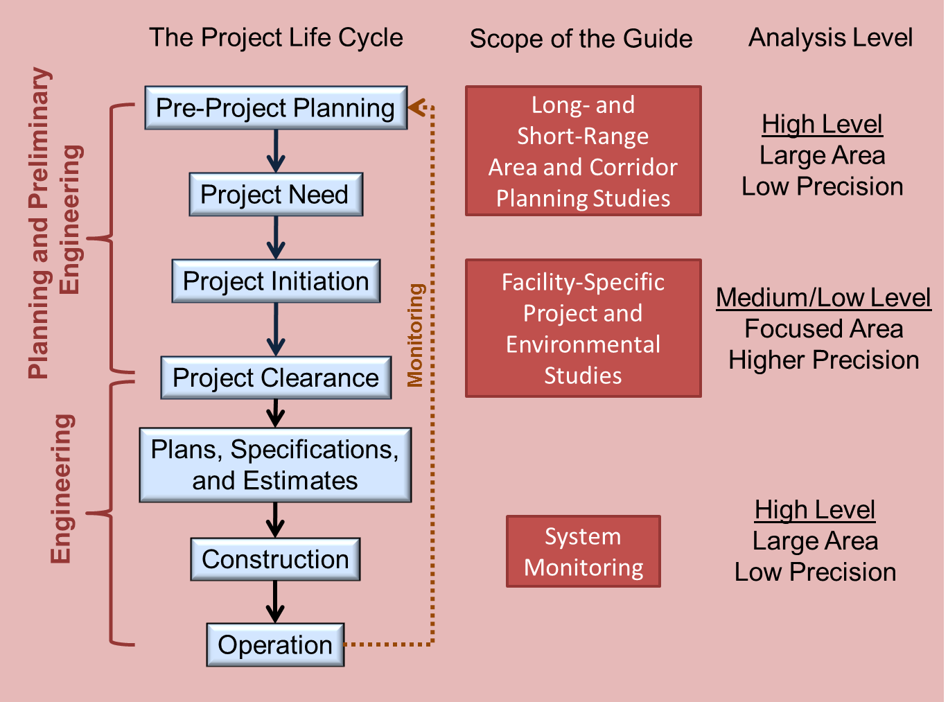
Guide’s Relationship to the Planning Process
Notes:
A roadway project goes through many stages from concept to construction to operation. Initially, the potential need for a project is identified through a long- or short-range areawide or corridor-based plan. Later, if selected for further development and if funding is available, a project will move into the project initiation and project clearance stages, and facility-specific project and environmental plans will be developed. Once the project moves into final design, it moves out of the realm of planning and preliminary engineering. However, once the project is constructed and in operation, it becomes part of the overall transportation system and a subject for system performance monitoring. As performance monitoring covers large areas at low levels of precision, planning and preliminary engineering techniques for estimating roadway operations performance measures again become applicable.

Slide 43
Presentation Overview
Need for the P&PE Applications Guide
Guide Scope and Structure
Guide Outline
Notes:
We will now begin to explore the Guide’s contents, starting with Part 1: Overview.

Slide 44
Guide Outline
Part 1: Overview
  Gateway to the Guide for non-HCM users
  Information cross-referenced throughout the Guide
Part 2: Medium-Level Analysis
  Gateway to the Guide for current HCM users
  Planning tools for HCM system elements
  (points, segments, facilities)
Part 3: High-Level Analysis
  Guidance on extending the HCM to corridors, areas, and transportation systems
Part 4: Case Studies
Notes:
Recognizing the breadth of the Guide’s target audience, the Guide has been structured so that it can been approached in different ways. Importantly, the Guide is designed as a reference work that is not intended to be read cover to cover. Non-HCM users access the Guide via Part 1, while HCM users are referred to appropriate parts of the Guide directly from the HCM. These gateways then refer readers to appropriate sections in Parts 1–4 for more information and examples. In addition to providing an overview of the Guide, Part 1 provides sections on topics cross-referenced throughout the Guide. Part 2 is divided into sections corresponding to HCM system elements (e.g., freeway facilities or signalized intersections), plus sections on multimodal analysis and truck level of service. Part 3 provides guidance on extending the HCM to larger study areas, including corridors, areas, and entire transportation systems. Finally, Part 4 provides three case studies demonstrating many of the methods provided in the Guide. The remainder of this web briefing will cover each parts in detail.

Slide 45
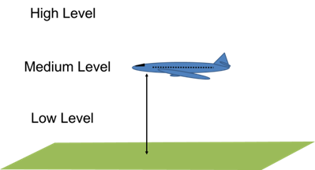
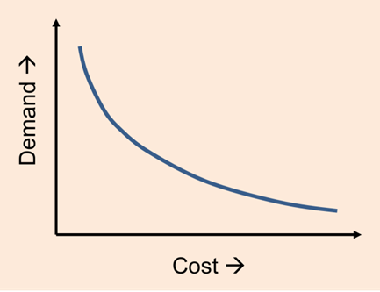
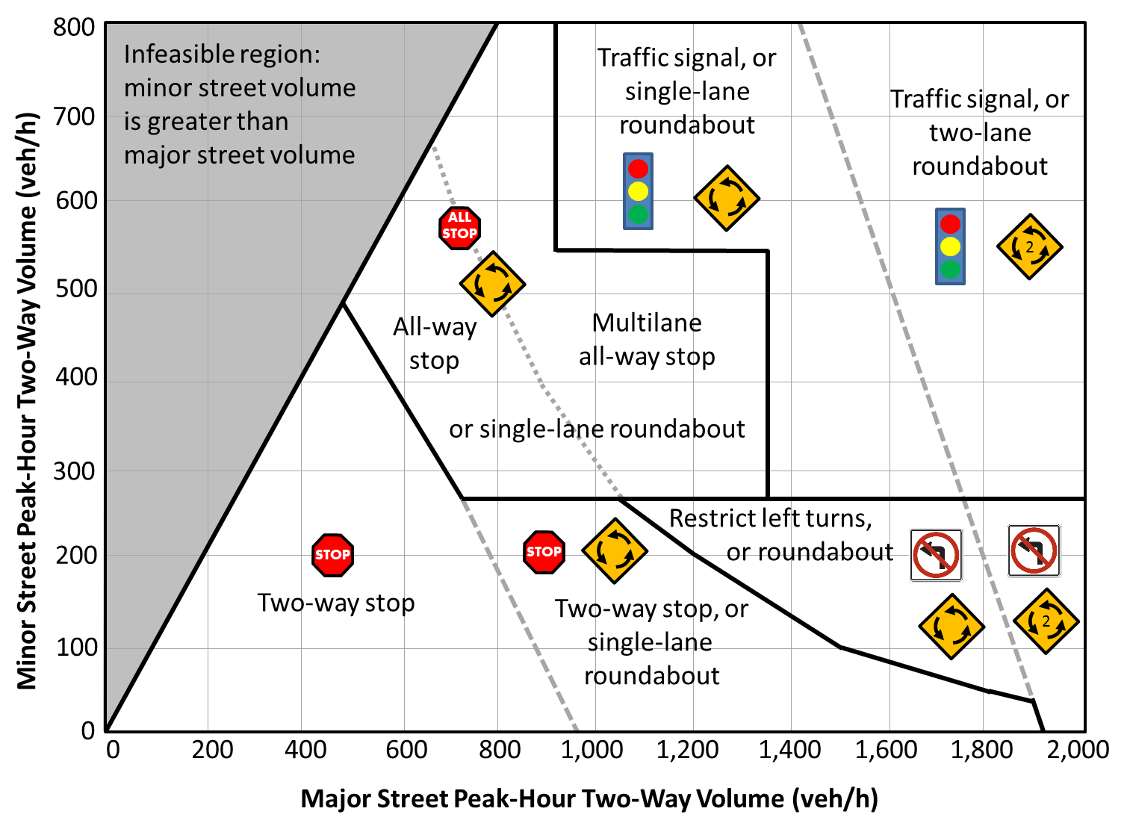
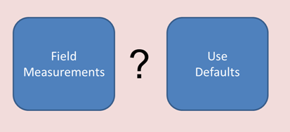
Part 1: Overview
A. Introduction
B. Medium-Level
(Facility-Specific) Analyses
C. High-Level Analyses
D. Working with Traffic Demand Data
E. Predicting Intersection Traffic
Control
F. Default Values
G. Service Volume Tables
Notes:
To avoid confusion with the HCM’s volume and numbered chapter structure, the Guide is organized by parts and lettered sections. Part 1 contains 7 sections. Section A provides an introduction to the guide. Sections B and C are the gateway to the Guide for planners and modelers. Sections D through G provide reference information used throughout the Guide.
[Replace placeholder with an image of the PPEAG cover]

Slide 46
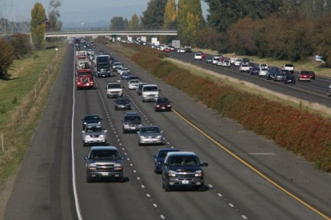
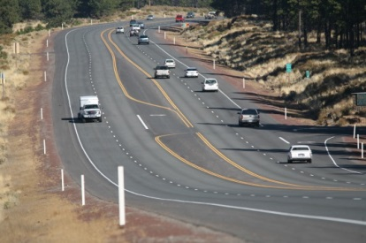
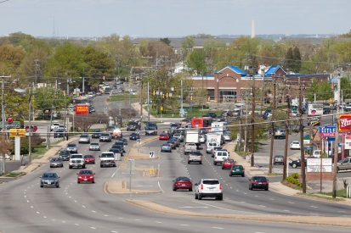


Part 2: Medium Level Analyses
H. Freeway Analyses
I. Multilane Highways
J. Two-Lane Highways
K. Urban Streets
L. Signalized Intersections
M. Stop-Controlled Intersections
N. Roundabouts
O. Pedestrians, Bicyclists, and Public Transit
P. Truck Level of Service
Notes:
Part 2 contains 9 sections and is likely to be the first point of entry to the Guide for regular users of the HCM. Each HCM chapter presenting an analysis methodology cross-references the Part 2 section in the Guide that contains the corresponding planning guidance and methods. Sections H–N each cover one of the main types of HCM roadway system elements from the perspective of motorized vehicle operations. They are structured similarly and we’ll look at them as a group in a moment. Section O provides planning methods for the pedestrian, bicycle, and public transit modes for all of the system elements for which the HCM provides methods. Finally, Section P presents a method for estimating truck level of service that fills a gap in the HCM’s analysis toolbox.
[Replace placeholder with an image of the PPEAG cover]

Slide 47
Typical Part 2 Section Outline
Overview
Applications
Analysis Methods Overview
Scoping and Screening Method
Section Analysis Applying the HCM with Defaults
Simplified HCM Facility Method
Reliability (freeways, urban streets, signals)
Multimodal LOS cross-reference
Case study cross-reference
Notes:
Sections H–N have similar outlines, although not every section covers every topic listed above, and some sections cover additional topics. The first three subsections define the system element described in the section, list the potential planning and preliminary engineering applictions that the Guide’s methods can be applied to, and list the analytical methods covered in more detail in the remainder of the section. We’ll look at these methods over the next few slides. The freeway and urban street sections (and, to a lesser extent, signalized intersections) provide methods for estimating a variety of travel time reliability measures. The sections conclude with cross-references to the multimodal level of service methods for the system element in Sections O and P, and to applicable case studies in Part 4.

Slide 48
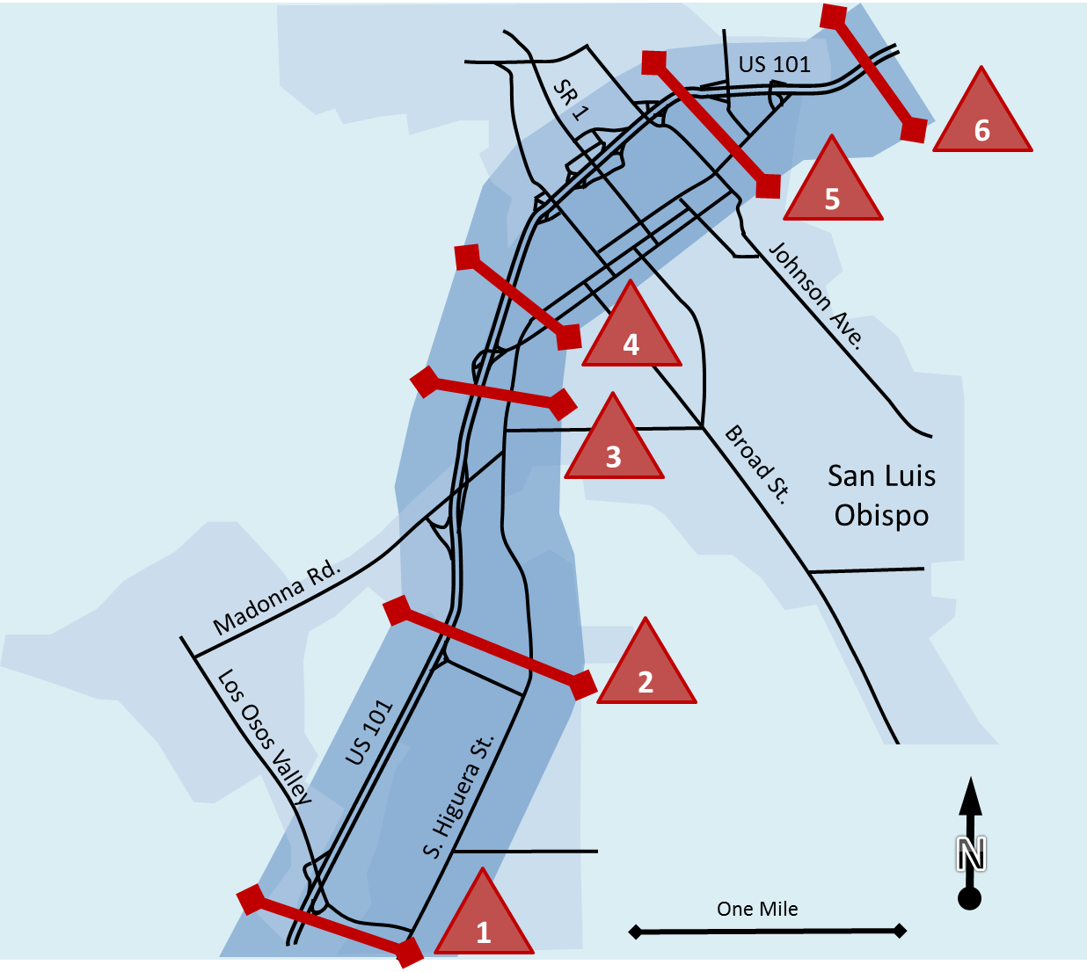
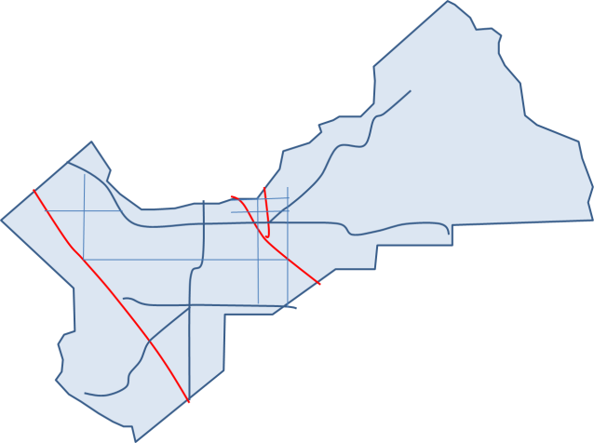
Part 3: High Level Analyses
Q. Corridor Quick Estimation Screenline Analysis
R. Areas and Systems
S. Roadway System Monitoring
Florida DOT
Notes:
Part 3 contains 3 sections that extend HCM methods to the analysis of corridors, areas, and systems.

Slide 49
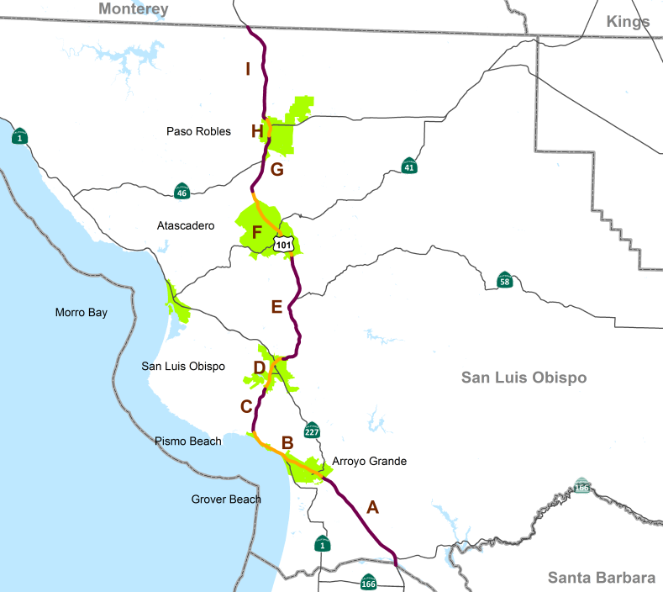

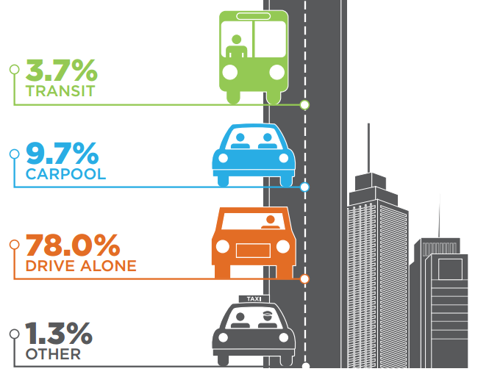
Part 4: Case Studies
T. Case Study 1: Freeway Master Plan
U. Case Study 2: Arterial Bus Rapid Transit Analysis
V. Case Study 3: Long-Range Transportation Plan
Miami–Dade MPO
Notes:
Part 4 contains 3 case studies that illustrate the application of many of the methods presented in Parts 2 and 3 of the Guide. The case studies cover the analysis of a 120-km section of freeway, a proposed new bus rapid transit route (with exclusive bus lanes) along a series of urban streets, and the application of HCM methods to a long-range transportation plan.

Slide 50
Questions
Note: The P&PE Applications Guide is available free online:
Search for NCHRP 825
50
Notes:
This concludes the overview of the three case studies provided in the Guide. I will now take the remaining time to answer questions on the case studies, as well as answer questions on earlier portions of the web briefing.

