Slide 1
California Connected Vehicle Test Bed
Caltrans DRISI
California PATH (UC Berkeley)
January 17, 2018

Slide 2
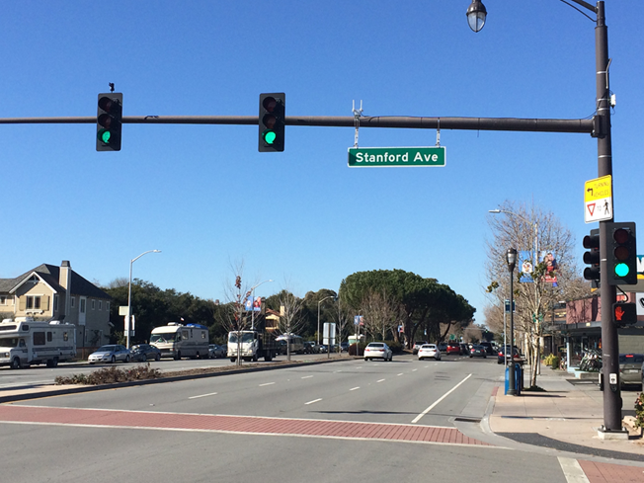
California Connected Vehicle Test Bed
Established in Palo Alto in 2005 by Caltrans, the Metropolitan Transportation Commission, and PATH
First-in-the-nation facility for testing CV applications using Dedicated Short Range Communications (DSRC) on public roads
Located on El Camino Real (SR 82)
2.1 miles long
11 consecutive intersections
6 more planned
AADT of 50K vehicles/day
Busy transit corridor
Notes:
AADT - Annual average daily traffic
RTCM - Radio Technical Commission For Maritime Services or RTCM Corrections Message, using RTCM standard 10403.1 & 10402.3

Slide 3
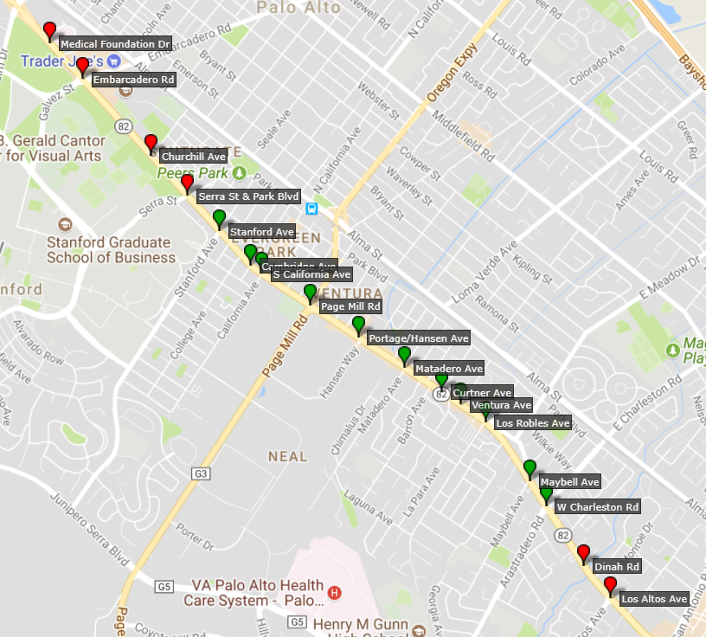
California Connected Vehicle Test Bed
Running MMITSS-CA applications bundle
I-SIG: BSM-based vehicular phase call and extension
TSP: Transit signal priority
FSP: Freight signal priority
PED-SIG: partner with Savari SmartCross Application

Slide 4
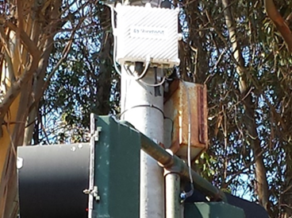
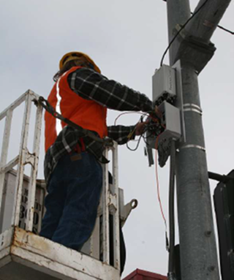
California Connected Vehicle Test Bed
Each intersection equipped with a DSRC Roadside Unit (RSU) broadcasting:
Signal Phase and Timing (SPaT)
Geometric Map (MAP)
Signal Status Message (SSM)
RTCM Corrections messages (planned)
PATH serves as technical consultant
Several companies have used the test bed for application development and testing
Ready and available for new application development
Notes:
AADT - Annual average daily traffic
RTCM - Radio Technical Commission For Maritime Services or RTCM Corrections Message, using RTCM standard 10403.1 & 10402.3

Slide 5
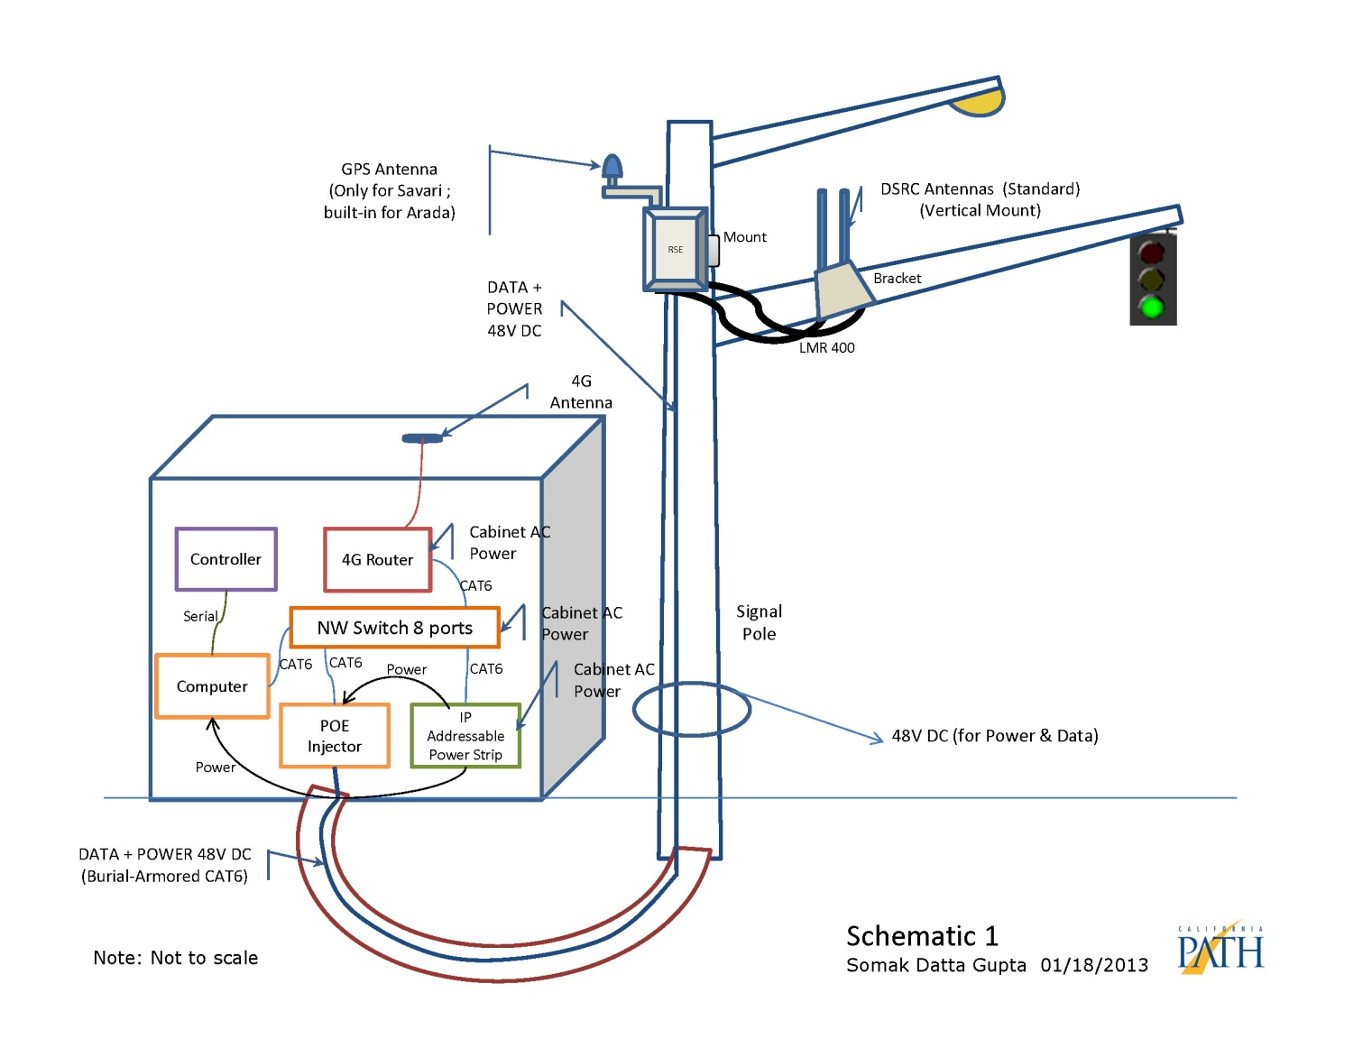
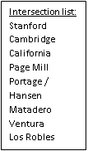
Example Layout Schematic (Roadside)
Notes:
Use animation to see slide

Slide 6
Example Intersection (Matadero)

Slide 7
Example Intersection Design
A = Antenna
R = RSU
C = Cabinet
A
R
C
Install antenna (A) on mast arm with bracket.
Install RSU (R) on upright above mast arm.
Connect RSU to antenna with 30’ coax cables.
Connect RSU to cabinet (C) through pole and pull boxes with PoE cable.
Install CV equipment in existing auxiliary cabinet and connect to existing 2070 controller and other equipment per cabinet diagram.

Slide 8
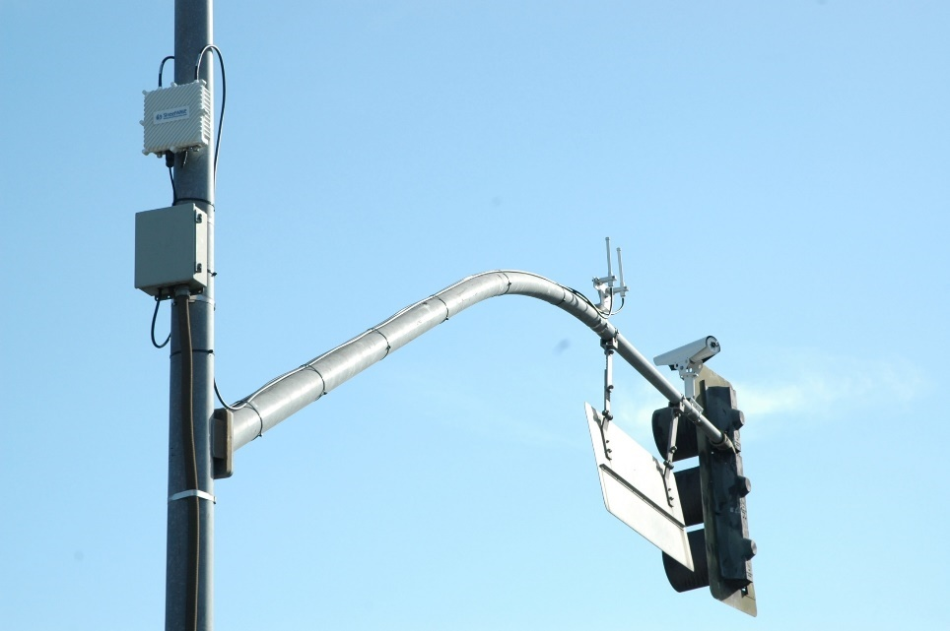
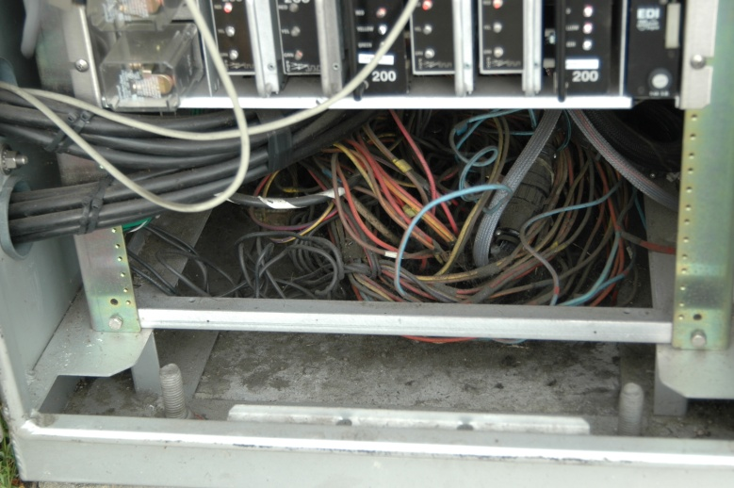
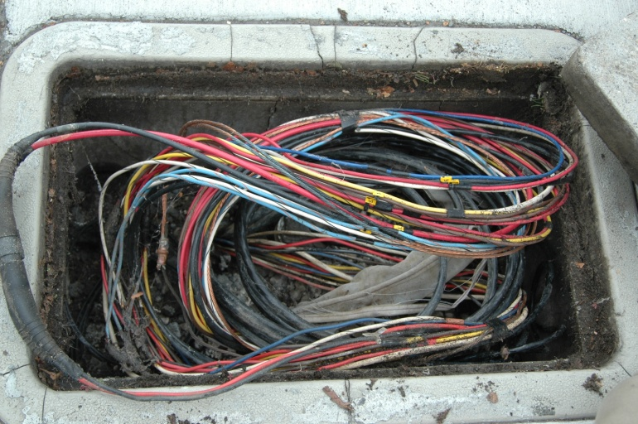
Actual Installation (RSU and Antenna)
Page Mill Road and El Camino Real
Notes:
View of the completed installation looking southbound up El Camino Real.

Slide 9
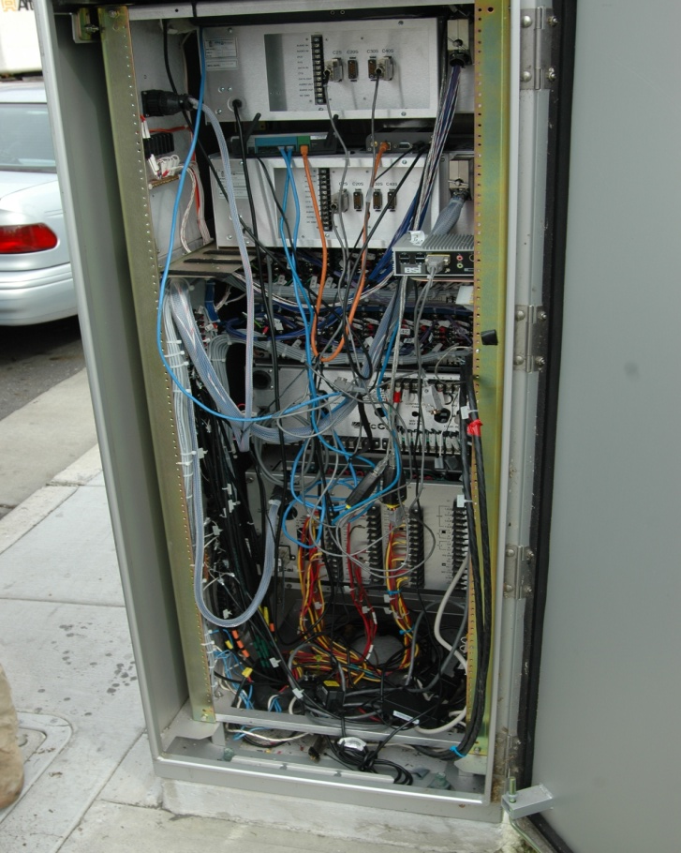
Actual Installation (Cabinet)
Back
Side Cabinet

Slide 10
DSRC Messages, Frequency, PSID, and Communication Channel at Palo Alto Test Bed
Message | Abbreviation | From | Frequency | To | Channel | PSID (Hex) | DSRC Message ID
Basic Safety Message | BSM | OBU | 10 Hz | RSU | 172 | 0p20 (0x20) | 20
Signal Request Message | SRM |  | Asynchronous |  |  | 0p80-02 (0x82) | 29
MAP/GID | MAP | RSU | 1 Hz | OBU |  |  | 18
Signal Phase and Timing | SPaT |  | 10 Hz |  |  |  | 19
Signal Status Message | SSM |  | 1 Hz |  |  |  | 30
RTCM Corrections Message | RTCM |  | Type 1004 – 5 Hz |  | 182 | 0p80-01 (0x81) | 28
 |  |  | Type 1006 – 2 Hz
 |  |  | Type 1008 – 2 Hz
Data samples of over-the-air DSRC messages are available at http://caconnectedvehicletestbed.org/index.php/datasample.php

Slide 11
California CV Test Bed Current Status and Plan for Early 2018
 | Current | Plan for early 2018
# of Intersections | 11 | 17
Roadside Unit (RSU) | Version 3.1 | Version 4.1 with security chip
Linux computer | Ubuntu 16.04.2 (latest) Linux kernel 4.10.0 (latest)
Backhaul | Router using wireless 3G | Upgrade to use 4G LTE
Broadcast Messages | MAP SPaT SSM | Add RTCM Corrections message
SAE J2735 Standard | Version 2016-03 (latest)
Data feed to National CV Data Warehouse |  | ✓
Integration with National SCMS |  | Work with RSU/OBU vendors and SCMS service provider
Notes:
SCMS - Security Credential Management System

Slide 12
CV Test Bed Support and Maintenance
Provided by PATH through multi-year Caltrans contract
Fix and replace any broken hardware and software
Keep up to date with the latest standards
Provide real-time data to National CV Data Warehouse
Develop web-based Test Bed “Health Monitoring” tool:
http://caconnectedvehicletestbed.org/
On-line “primer” on how to use the Test Bed
Description of available services
Frequency of broadcast messages (e.g. BSM, SPaT, SRM, etc.)
Tool for users to report issues on using the test bed, and to request assistance

Slide 13
CV Deployment Support and Application Development
Provided by PATH in partnership with UC Riverside
Test Bed expansion and enhancement
CV application development and testing
Adaptive transit signal priority
Connected Eco-Approach/Departure application for transit and heavy vehicles (partnering with UC Riverside)
Partner with Santa Clara VTA for testing and evaluation of transit applications
Technical assistance to Caltrans on CV deployment
Demonstrations

Slide 14
Multi-Modal Intelligent Traffic Signal System (MMITSS)
Funded through the Connected Vehicle PFS, led by VDOT
Additional funding from USDOT Dynamic Mobility Applications (DMA) program
University of Arizona and California PATH Program
MMITSS applications bundle
I-SIG: Intelligent Traffic Signal System
TSP: Transit Signal Priority
FSP: Freight Signal Priority
EVP: Emergency Vehicle Signal Preemption (AZ)
PED-SIG: Pedestrian Mobility

Slide 15
MMITSS Status
Phase I: 2012 – 2013
ConOps, System Requirements, Preliminary Design
Phase II: 2013 – 2016
Two MMITSS prototypes built
MMITSS-AZ: adaptive traffic signal and priority control, NTCIP-based
MMITSS-CA: semi-actuated coordinated signal and priority control, uses Caltrans protocol (AB3418)
Demonstrated to FHWA on CA Test Bed in Nov 2015
Phase III: Jan 2018 - Mar 2019
Enhanced applications, more testing, deployment-focused, NTCIP
Documentation and source code available at CV PFS web site and on USDOT open-source portal
Notes:
OSADP – Open Source Application Development Portal

Slide 16
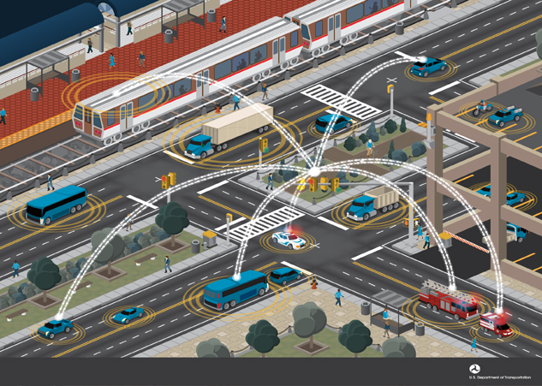
MMITSS-CA Operational Concept
Broadcast (DSRC)
BSM, SRM
Receive (DSRC)
SPaT, MAP, …
Broadcast (DSRC)
SPaT, MAP, SSM, RTCM
Receive (DSRC)
BSM, SRM
Broadcast
BSM
Broadcast
BSM, SRM
Receive
SPaT, MAP, …
Broadcast
BSM, SRM
Receive
SPaT, MAP, …
Notes:
BSM includes vehicle length and width
SRM includes vehicle type and basic role (police, fire, ambulance, transit, DOT, etc.)

Slide 17
The SPaT Challenge
http://www.transportationops.org/spatchallenge
A challenge to achieve:
Deployment of Signal Phase and Timing (SPaT) DSRC transmissions operating on a corridor of at least 20 intersections in 50 States by 2020
Commitment to operate and maintain for at least 10 years

Slide 18
The SPaT Challenge

Slide 19
The SPaT Challenge

Slide 20
The SPaT Challenge
Why would we do this?
It will give DOTs an entry into V2I deployment (valuable experience with procurement, installation, operations, and maintenance)
It will help promote future (more advanced) V2I deployments
It will show a commitment to the auto industry that we intend to deploy

Slide 21
Utilizing RTCM messaging via DSRC to improve vehicle localization
Many connected vehicle applications rely on continuous, reliable, and accurate vehicle localization (i.e., positioning)
Standard DSRC OBU’s contain GPS; however, the position information is not always reliable and accurate
It is possible to broadcast RTCM corrections via DSRC to improve reliability and accuracy

Slide 22
RTCM Version 3 (RTCM Standard 10403.x)
RTCMv3 defines new message data structure for real-time kinematic (RTK) applications, and supports GPS and GLONASS RTK operations.
RTCM DGNSS Standards
Message types in RTCMv3 have been structured in different groups.
For proper operation, the provider must transmit at least one message type from each of the following groups:
Observations,
Station Coordinates, and
Antenna Description

Slide 23
RTCMv3 RTK Message Groups
Group Name | Message Type | Message Description
Observations | 1001 | L1-Only GPS RTK Observables
 | 1002 | Extended L1-Only GPS RTK Observables
 | 1003 | L1&L2 GPS RTK Observables
 | 1004 | Extended L1&L2 GPS RTK Observables
 | 1009 | L1-Only GLONASS RTK Observables
 | 1010 | Extended L1-Only GLONASS RTK Observables
 | 1011 | L1&L2 GLONASS RTK Observables
 | 1012 | Extended L1&L2 GLONASS RTK Observables
Station Coordinates | 1005 | Stationary RTK Reference Station Antenna Reference Point (ARP)
 | 1006 | Stationary RTK Reference Station ARP with Antenna Height
Antenna Description | 1007 | Antenna Descriptor
 | 1008 | Antenna Descriptor and Serial Number

Slide 24
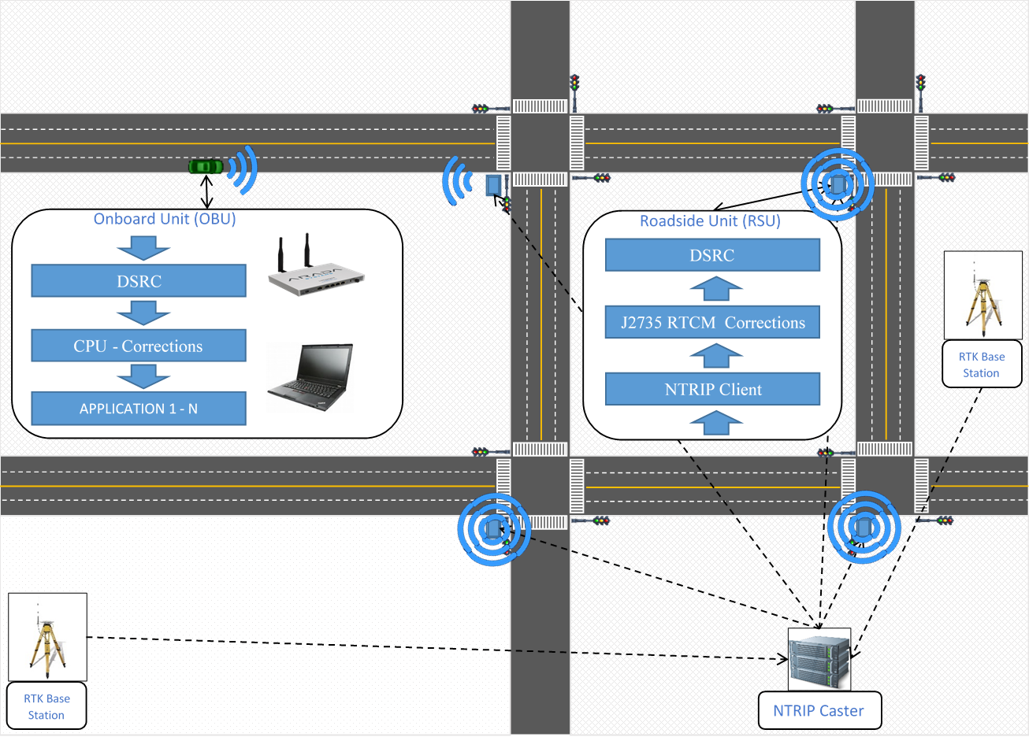
Architecture
Networked Transport of RTCM via Internet Protocol (NTRIP)
Streaming of differential GPS correction data over the Internet
RTK Base Station sends corrections to NTRIP Caster, enabling the NTRIP Caster to broadcast to all connected NTRIP clients

Slide 25
RTCM-NTRIP Configuration at Test Bed
Base Station (NTRIP Server): JRSC
Cooperatively operated by UC Berkeley and Stanford University
Located at Jasper Ridge Biological Preserve, Stanford, CA
About 5 miles west of the Palo Alto Test Bed
RTCMv3 type 1004, 1006, and 1008
Broadcasting at 1 Hz
NTRIP Caster located at UC Berkeley PATH Headquarters
NTRIP Client hosted by intersection roadside processor
NTRIP
Caster
cellular
internet

Slide 26
Positioning Experiments
Nearly all DSRC OBU’s utilize WAAS-corrected DGPS, typically providing 2-5 meter accuracy in Open Sky
RTCM2 provides correction information, communicated as a DSRC message
RTCM3 provides additional correction information, also communicated as a DSRC message
Positioning experiments underway:
 | DGPS (WAAS) |  | w/ RTCM2 |  | w/ RTCM3
 | Static | Dynamic | Static | Dynamic | Static | Dynamic
Open Sky | UCR, complete | UCR, complete | UCR, underway | UCR, underway | UCR, planned | UCR, planned
Rural Canyons | UCR, complete | UCR, complete | UCR, underway | UCR, underway | UCR, planned | UCR, planned

Slide 27
RTCM Testing at Test Bed
Test Bed RSU’s w/GPS (at fixed locations) receive RTCM corrections from nearby NTRIP Server (Jasper Ridge location) through the NTRIP Caster at PATH
Corrections are formatted into J2735 messages and broadcast
Test Bed intersections are closely spaced, so vehicles might receive DSRC messages from up to four nearby intersections
OBU/GPS (floating) receive RTCM messages from RSU’s within the communication range
For testing, we will use video as the ground truth

Slide 28
Standards to Ensure Interoperability
Hardware and Physical Layers:
IEEE 802.11p (frequency; bandwidth; channels)
IEEE 1609.0-.4 (architecture; security)
Message Sets and Performance:
SAE J2735 (DSRC\WAVE)
SAE J2945/1-9
Communications between Roadside Systems:
NTCIP 1202 version 3

Slide 29
Discussion
For more information, please visit:
http://caconnectedvehicletestbed.org/
Caltrans provides a safe, sustainable, integrated, and efficient transportation system to enhance California’s economy and livability

